Slide 1


PMT Testing
03/08/2024
Kirsten McMichael, Gen Li, Daniell Shi

Slide 2
Testing Parameters
ADC unit: 4 ns (250 MHz), 2/4096~0.488mV (2 Vpp, 12bit)
Warm up: 1400 V , 30 mins
Bias Voltages: 1400, 1500, 1600, 1700, 1800, 1900 V
LED on: 150kHZ, external trigger, 3.35 vpp LED, 10s DAQ
LED off (dark): 500Hz, external trigger, 0.8 vpp LED, 10mins DAQ

Slide 3
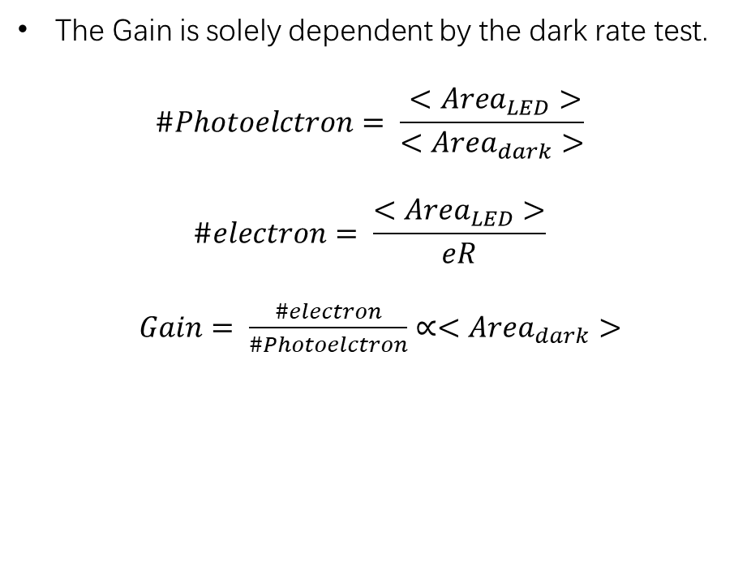
Gain
The Gain is solely dependent by the dark rate test.
$$\#Photoelctron= \frac{ <Area_{LED}>}{<Area_{dark}>}$$
$$\#electron= \frac{<Area_{LED}>}{eR}$$
$Gain= \frac{\#electron}{\#Photoelctron}∝<Area_{dark}>$

Slide 4
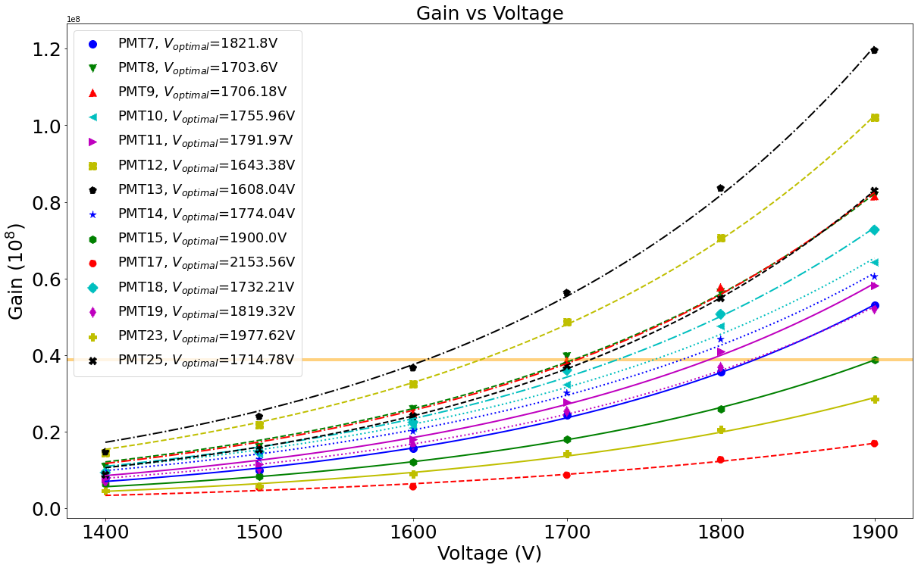
Comparison - Gain
According to the gain of PMT15 at 1900V, we found the working voltage for each PMT to get the same gain.
Except PMT23 and PMT17, we will set these two at 1900V
PMT23
PMT17

Slide 5
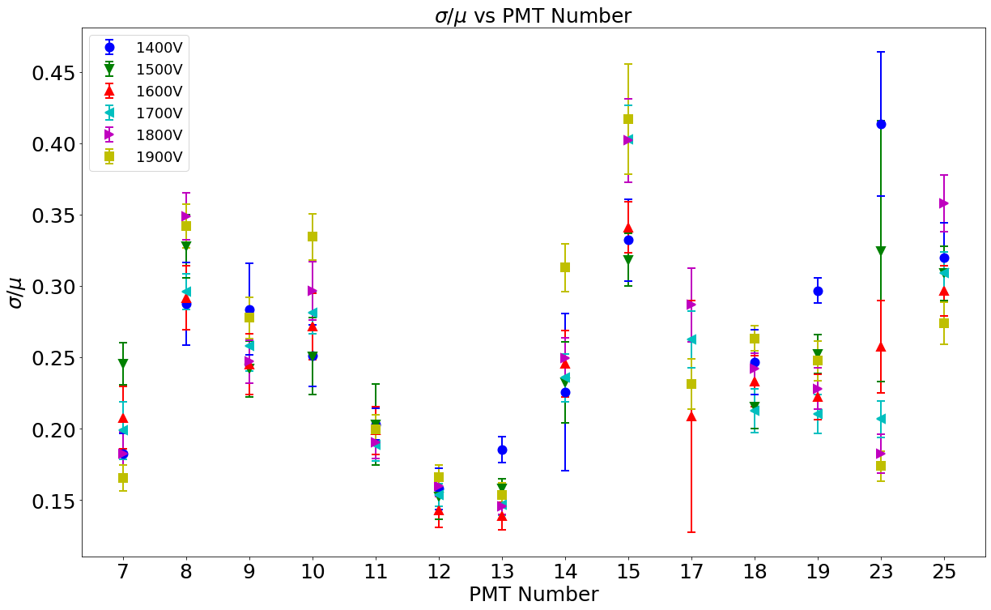
Comparison - Resolution

Slide 6
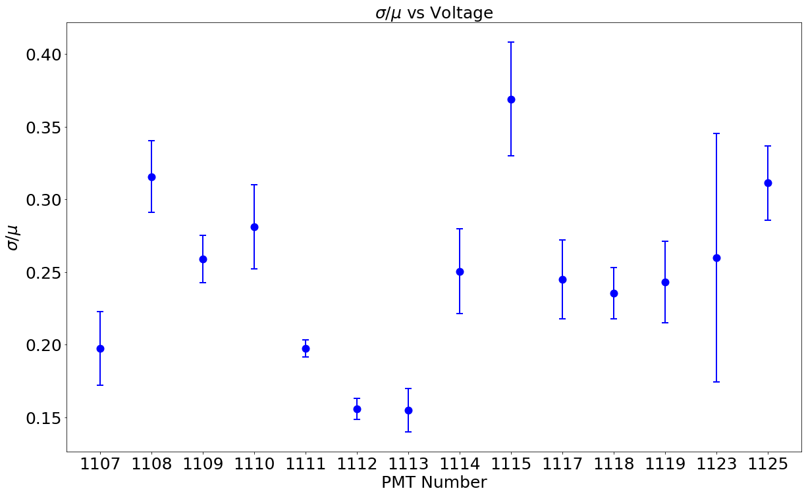
Comparison - Resolution

Slide 7
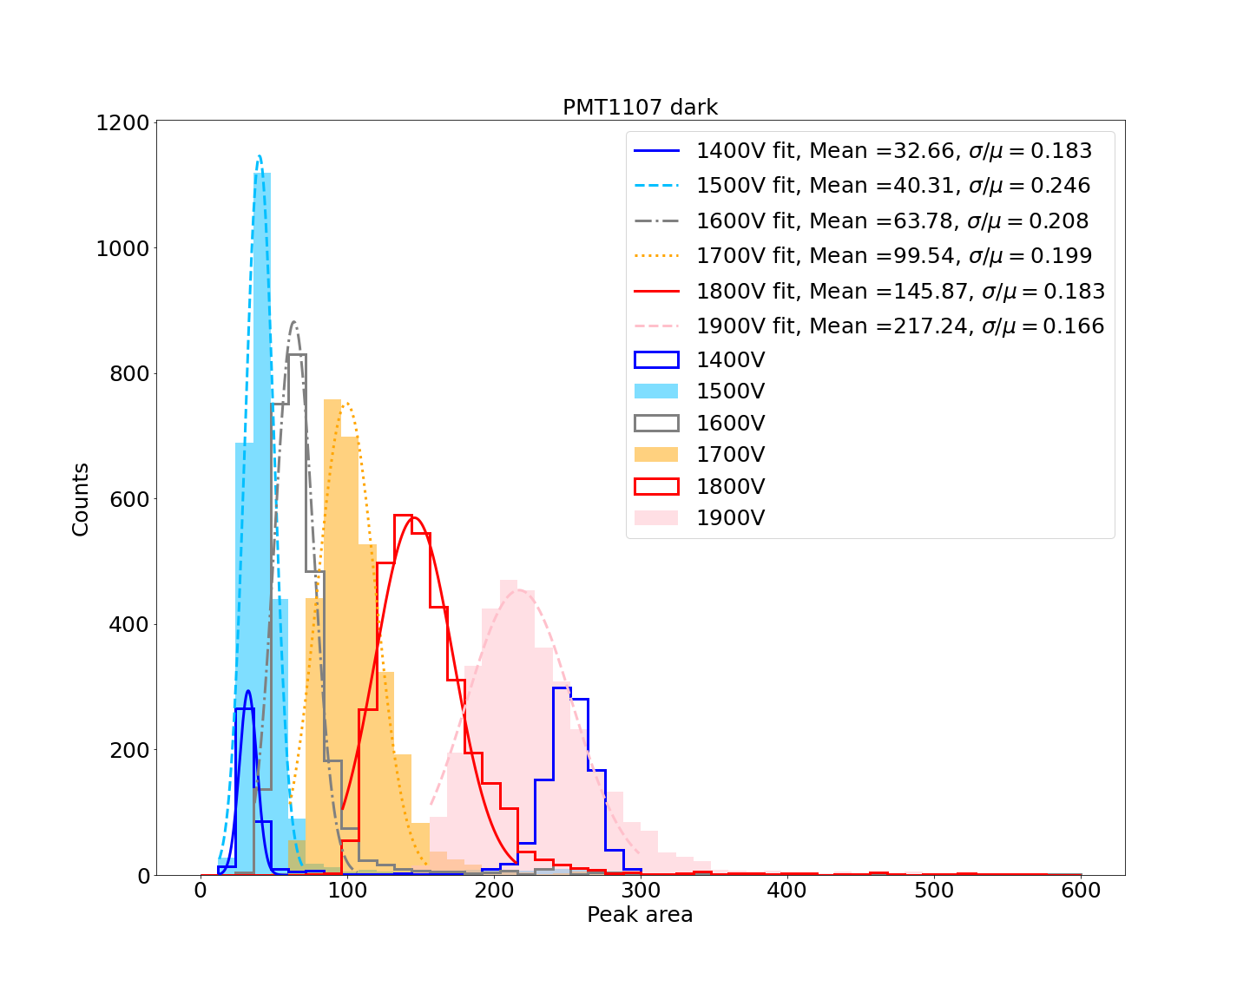
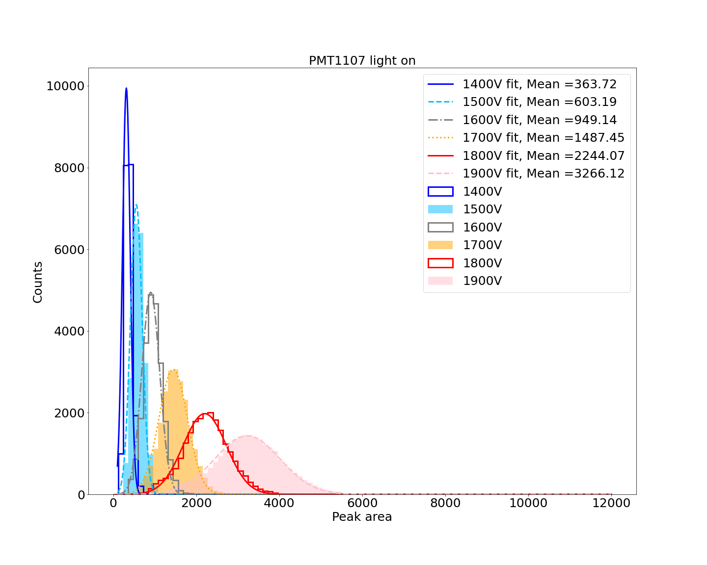
PMT1107

Slide 8
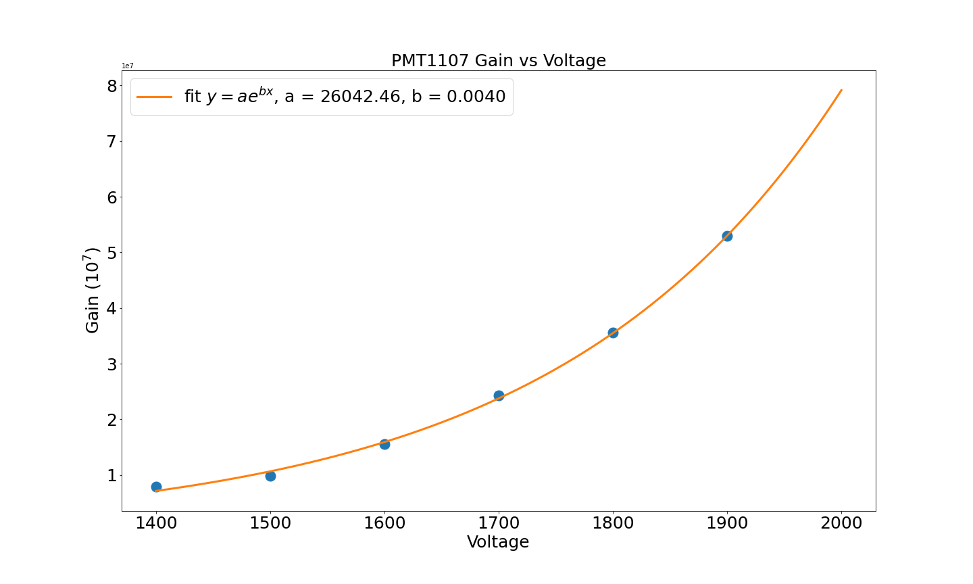
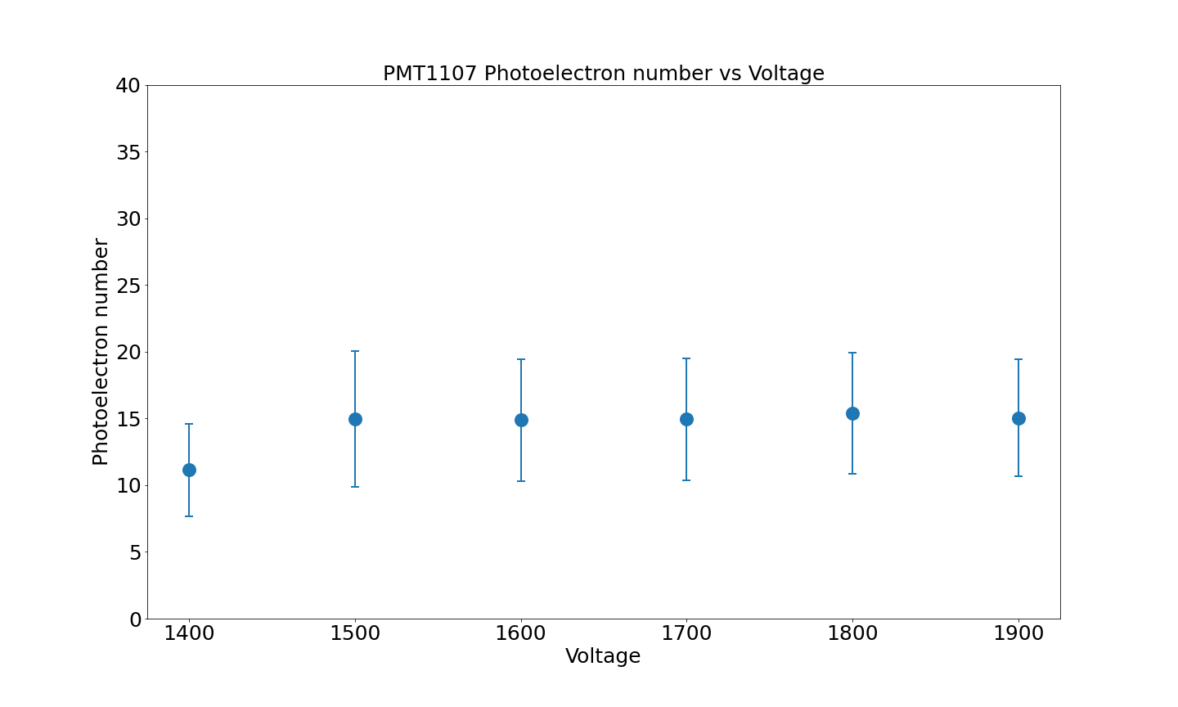
PMT1107

Slide 9
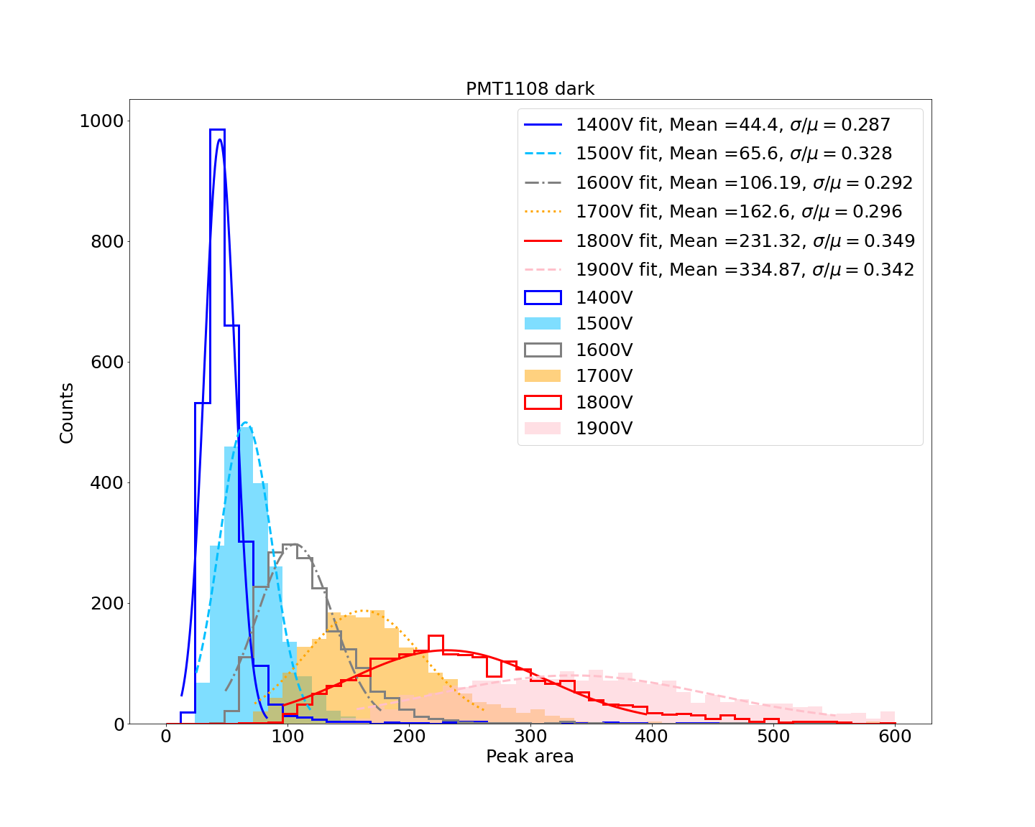
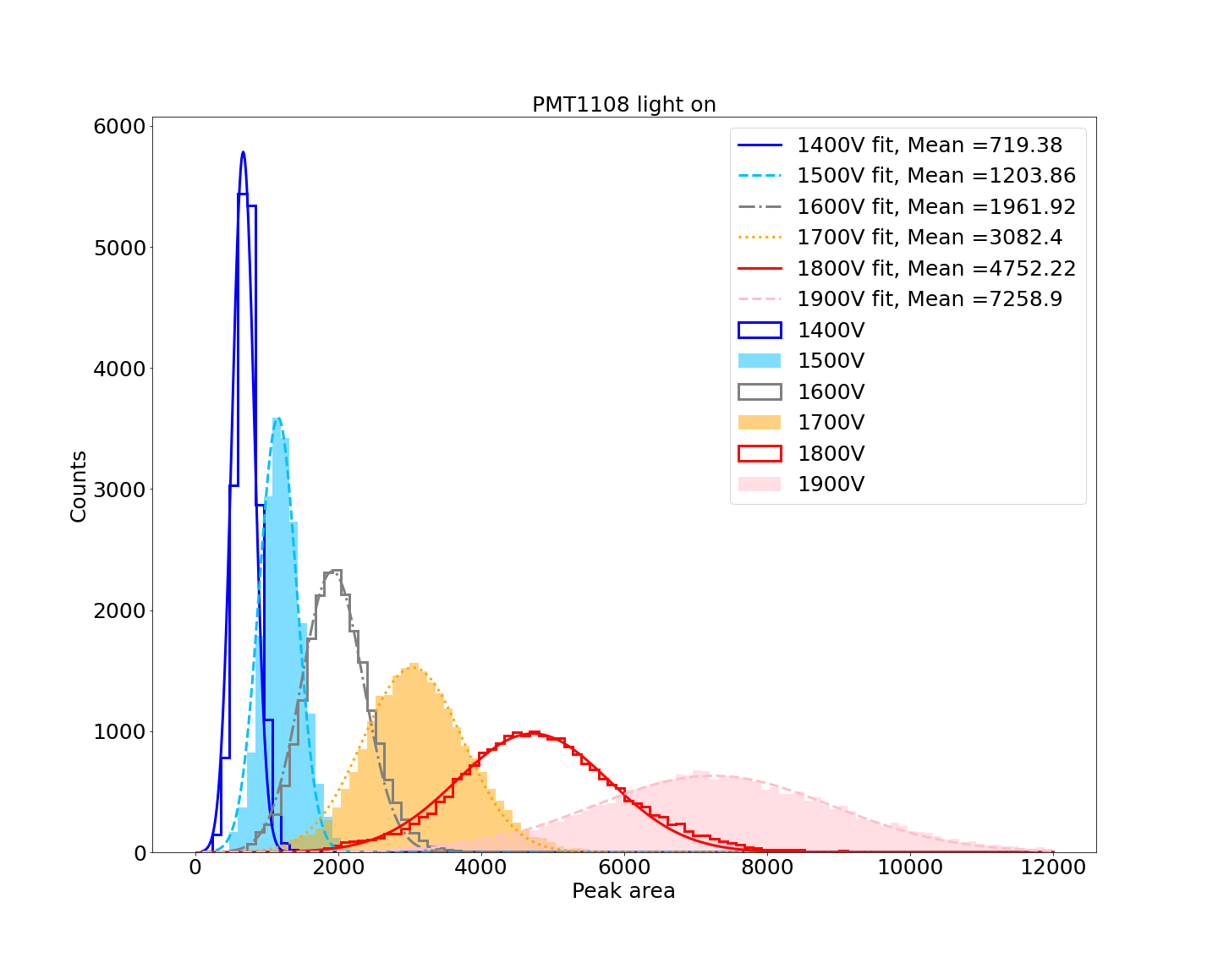
PMT1108

Slide 10
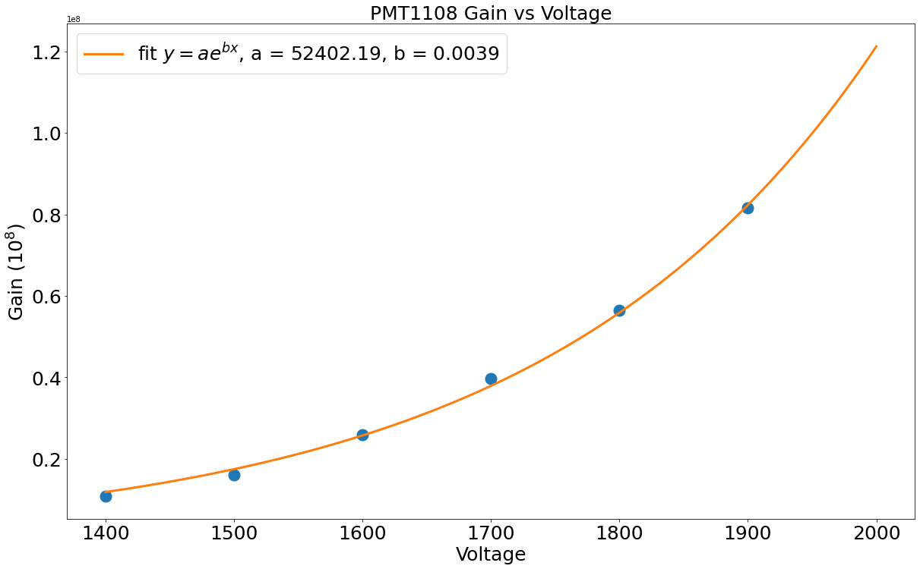
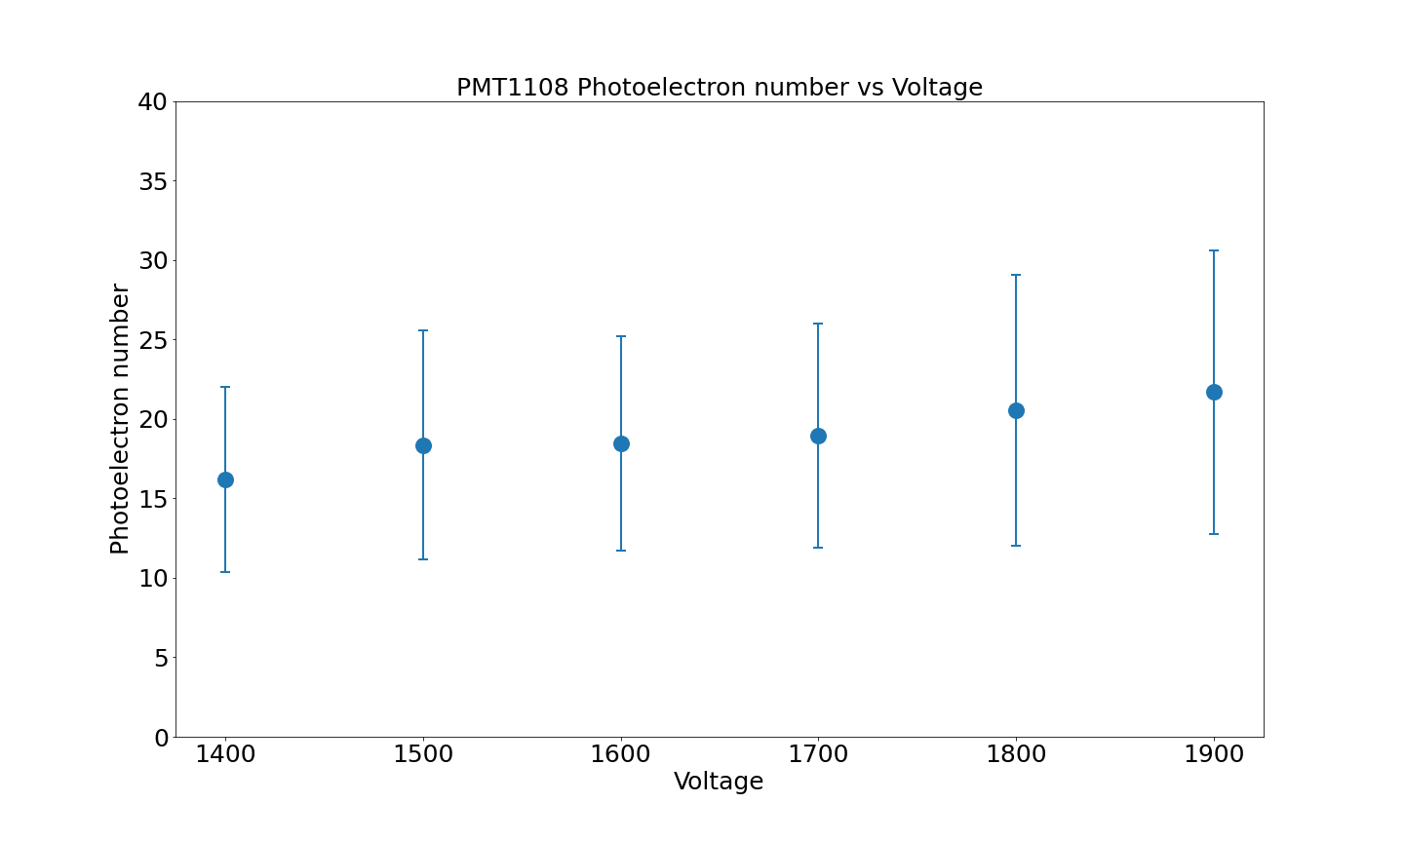
PMT1108

Slide 11
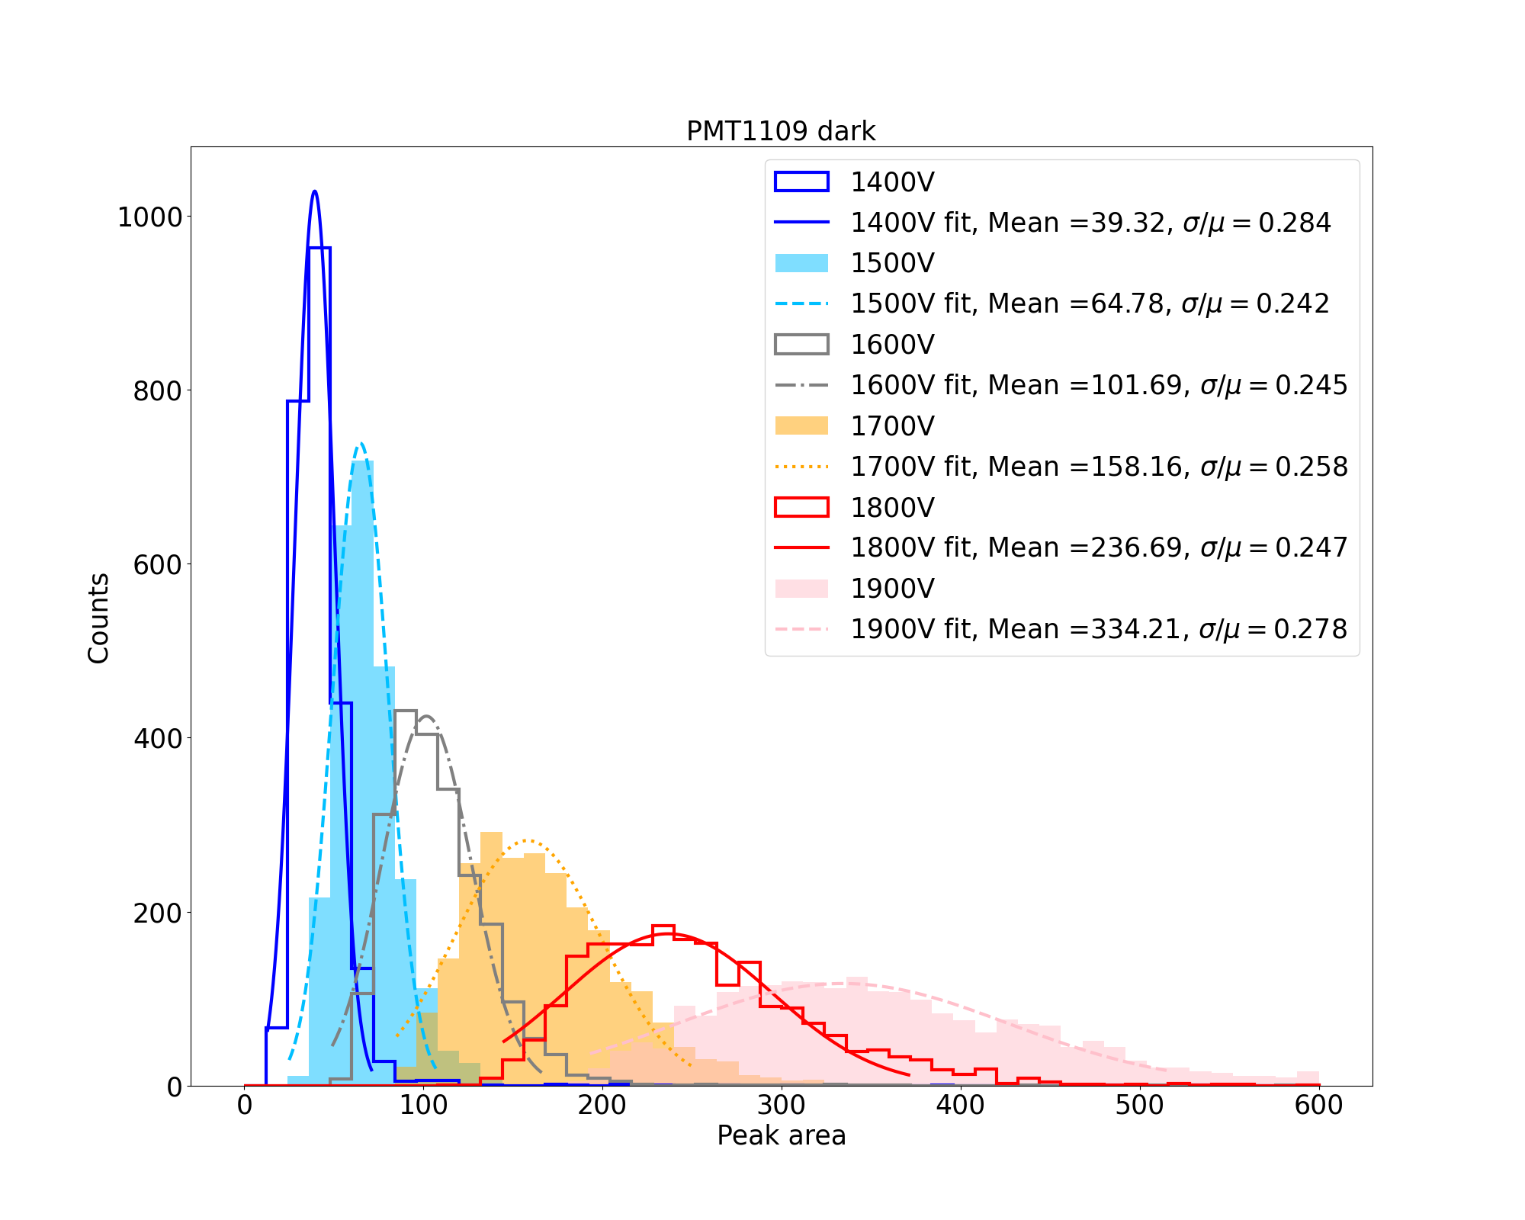
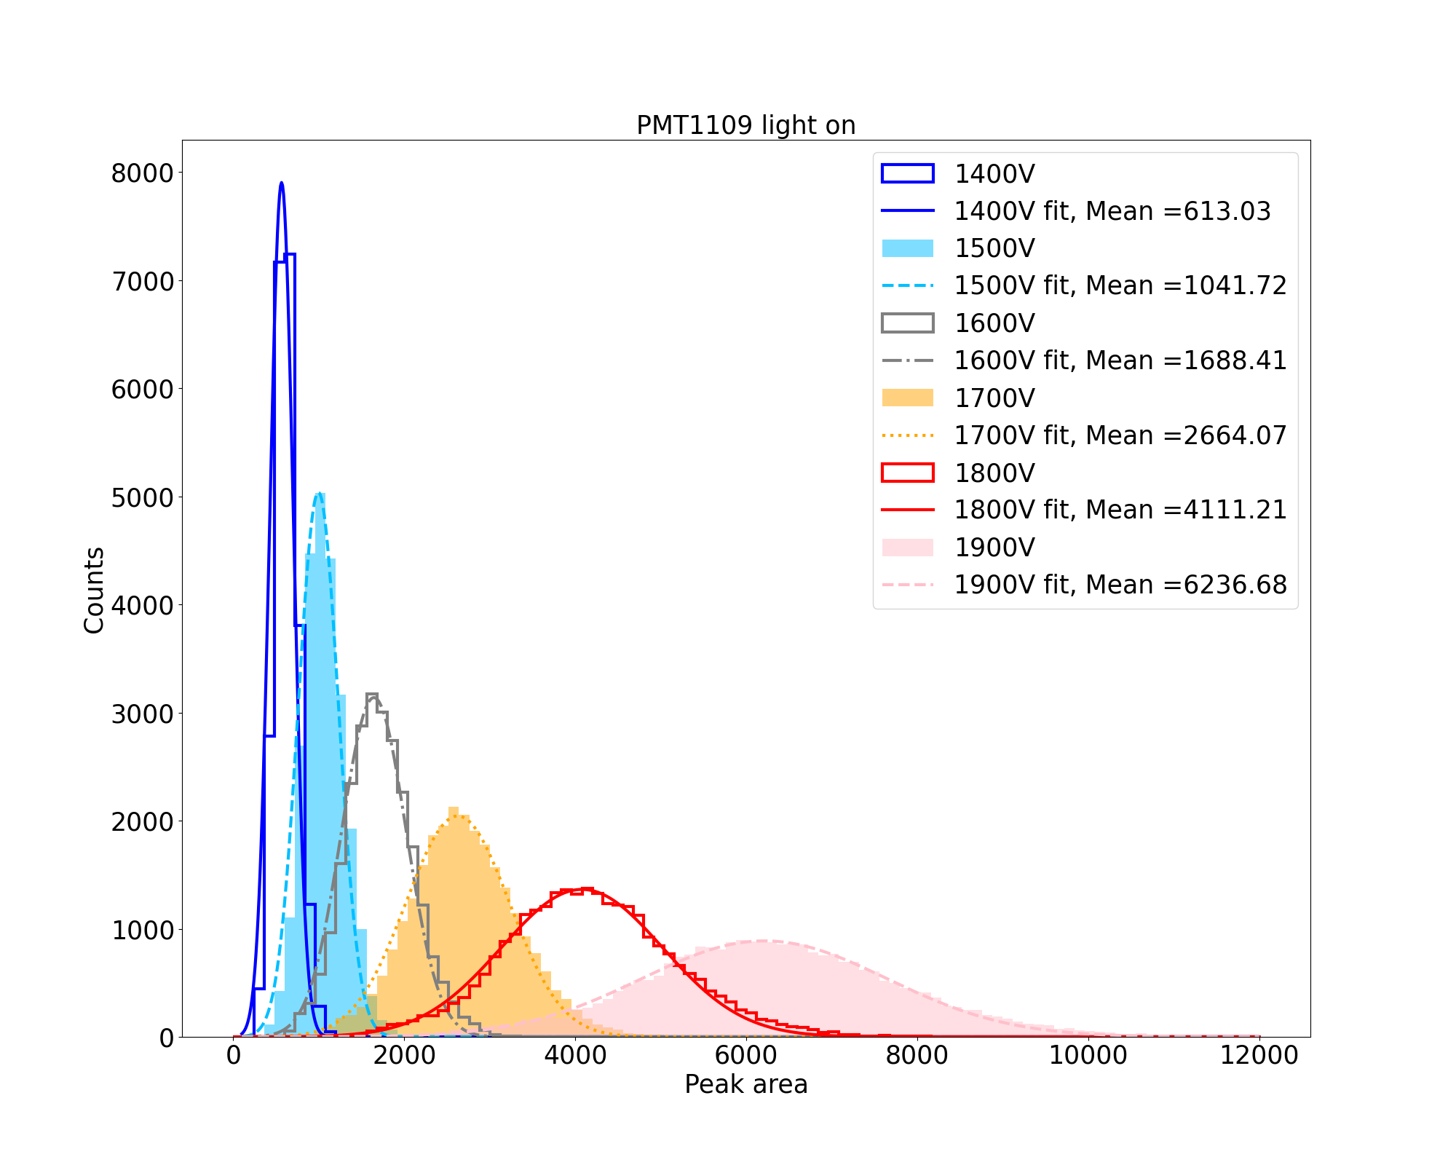
PMT1109

Slide 12
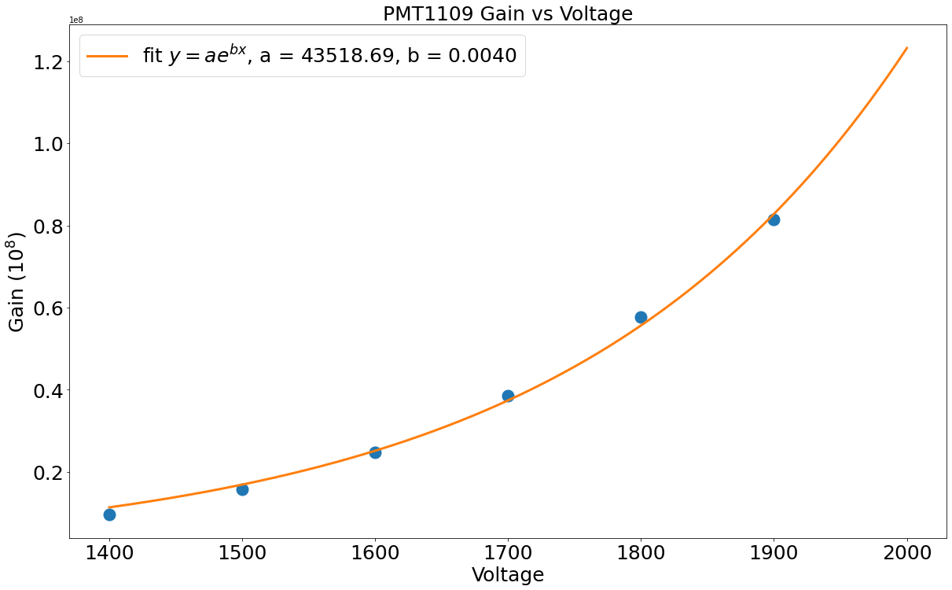
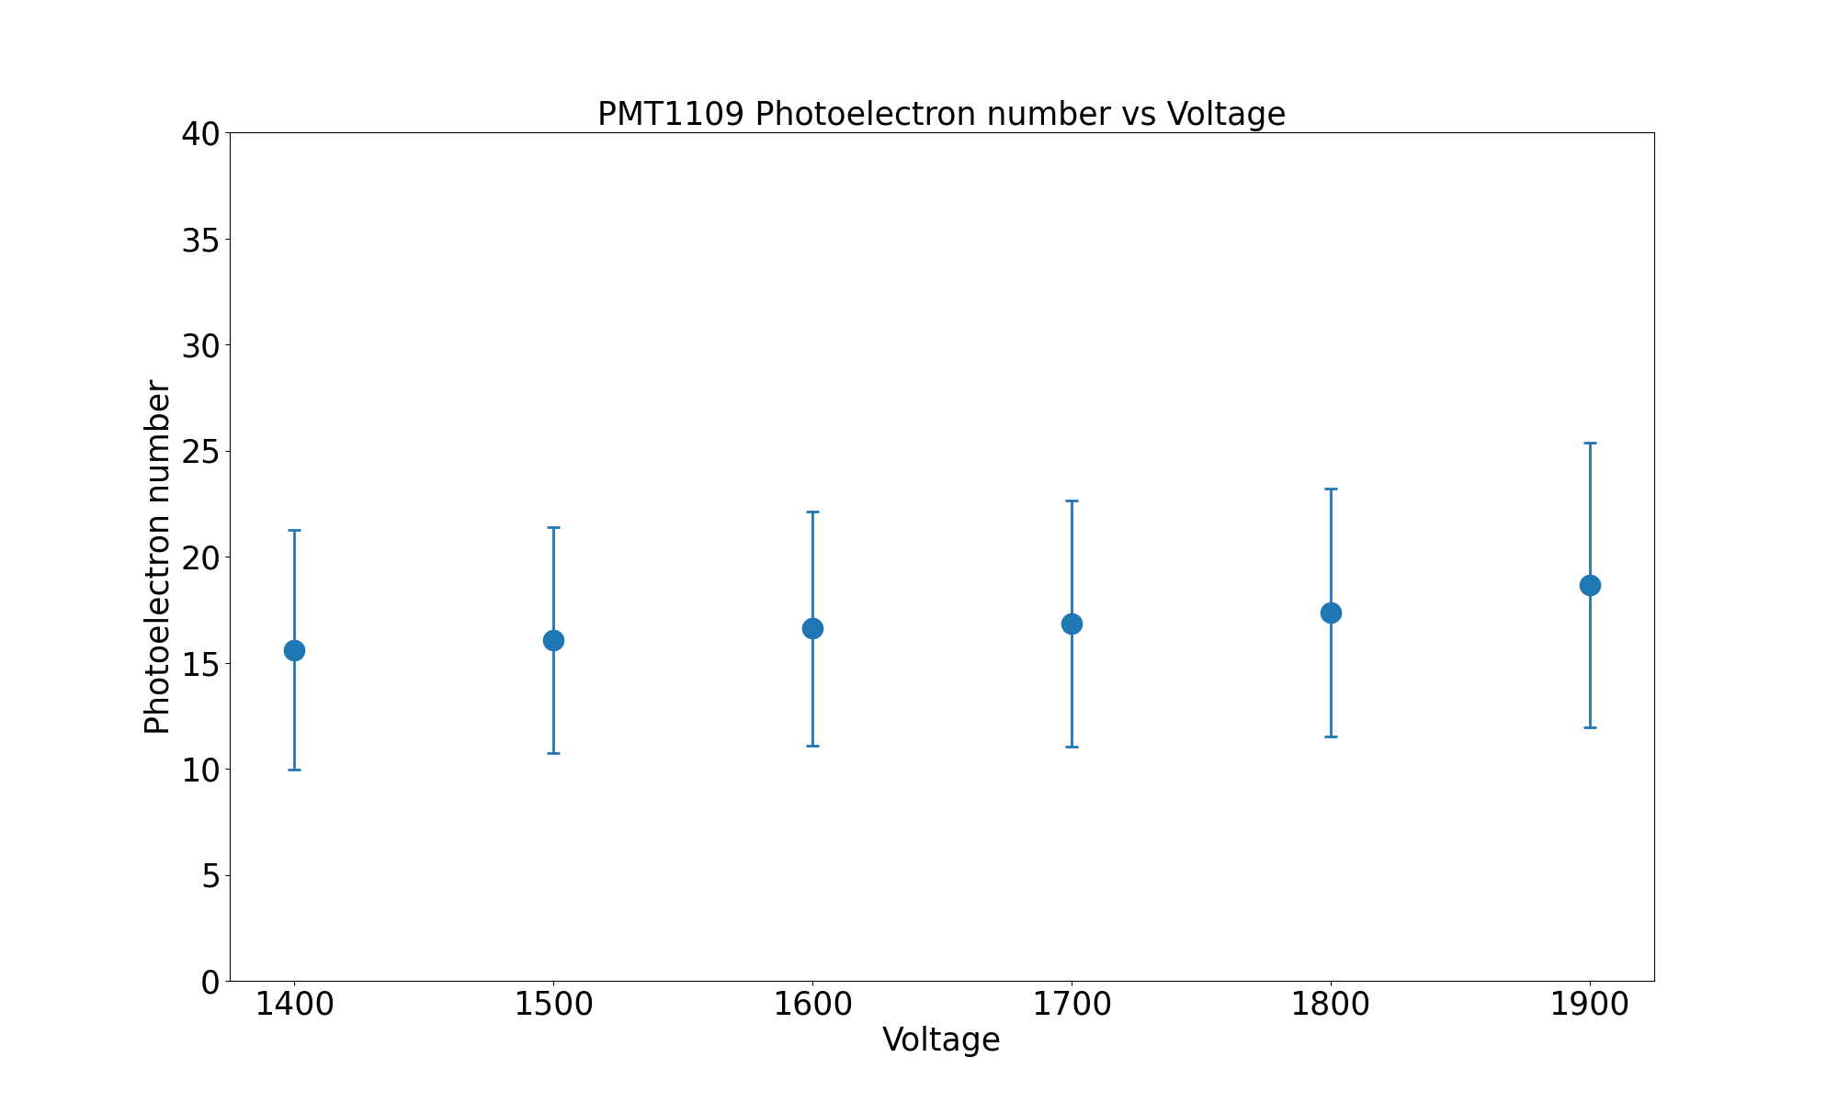
PMT1109

Slide 13
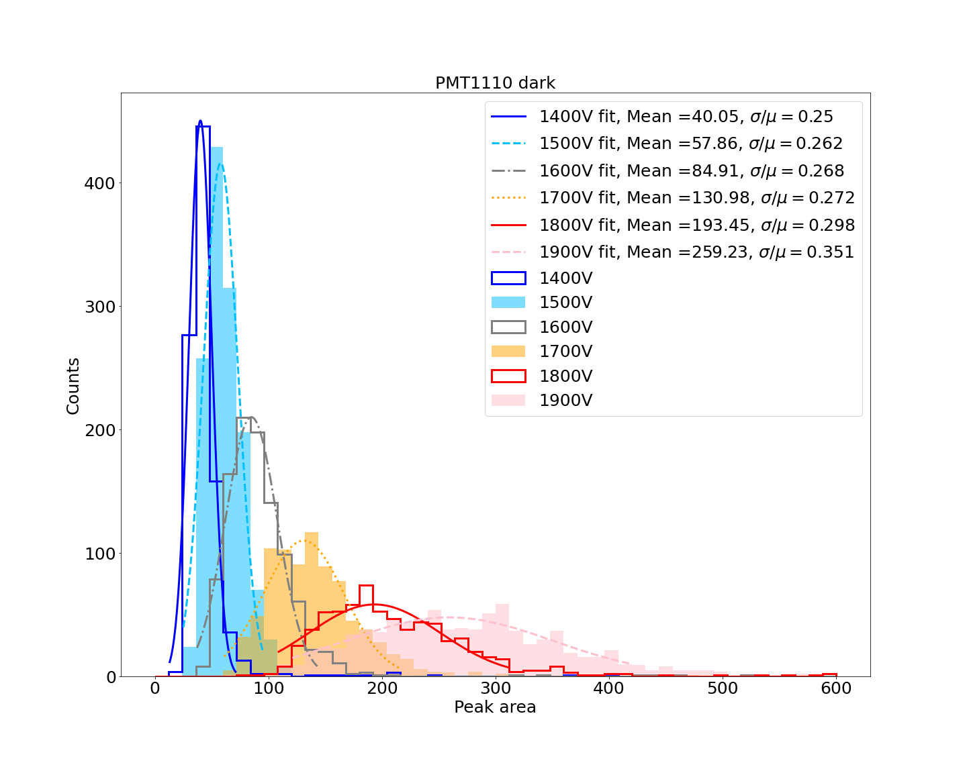
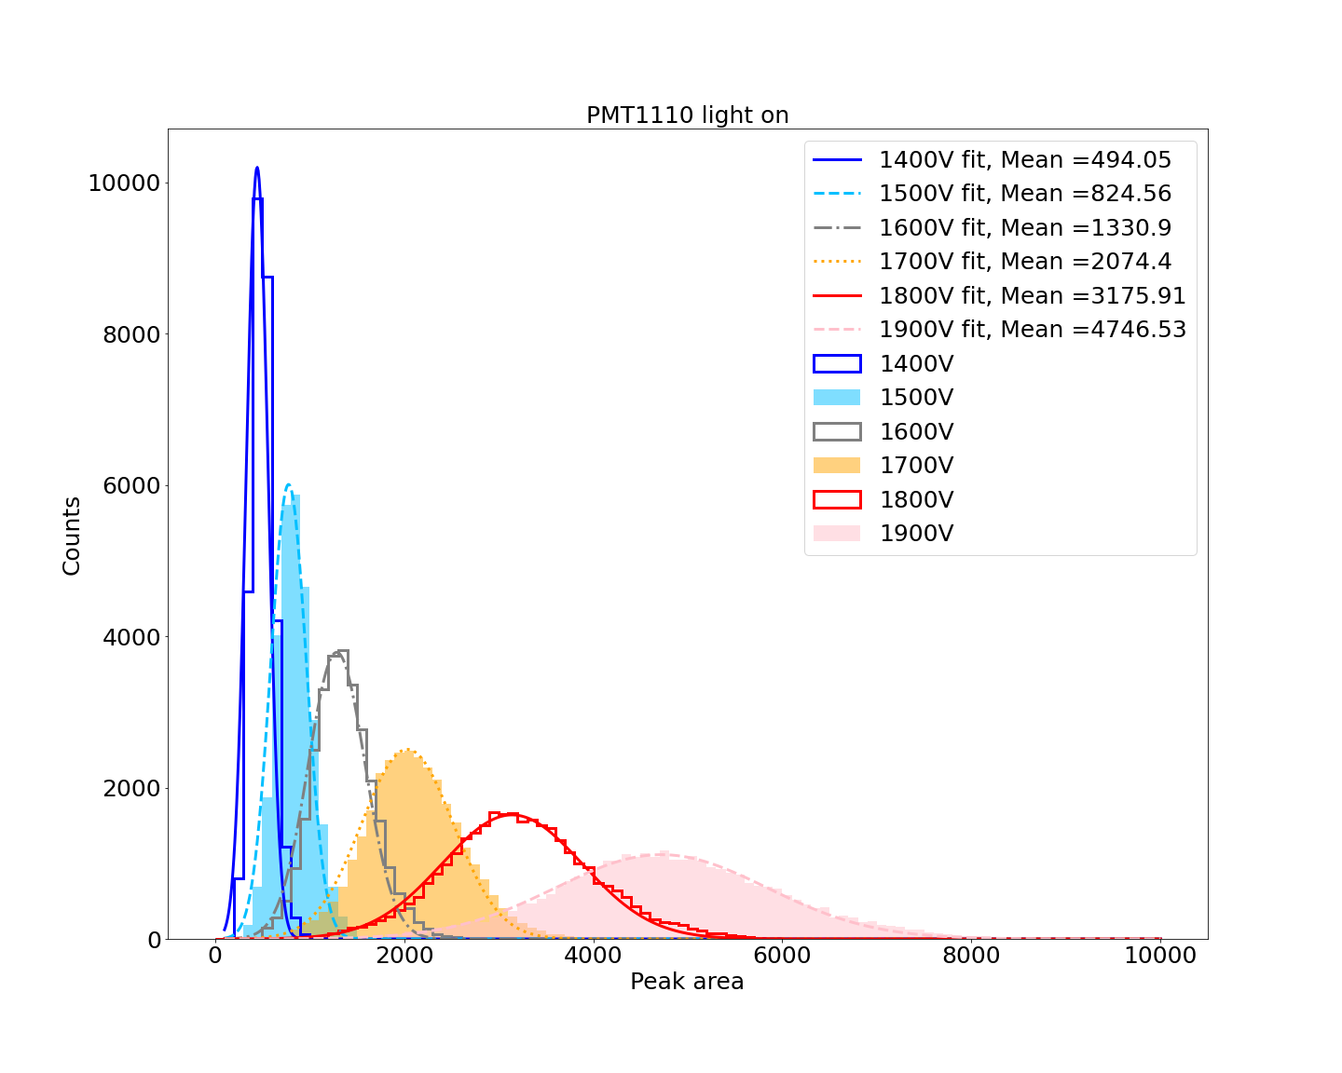
PMT1110

Slide 14
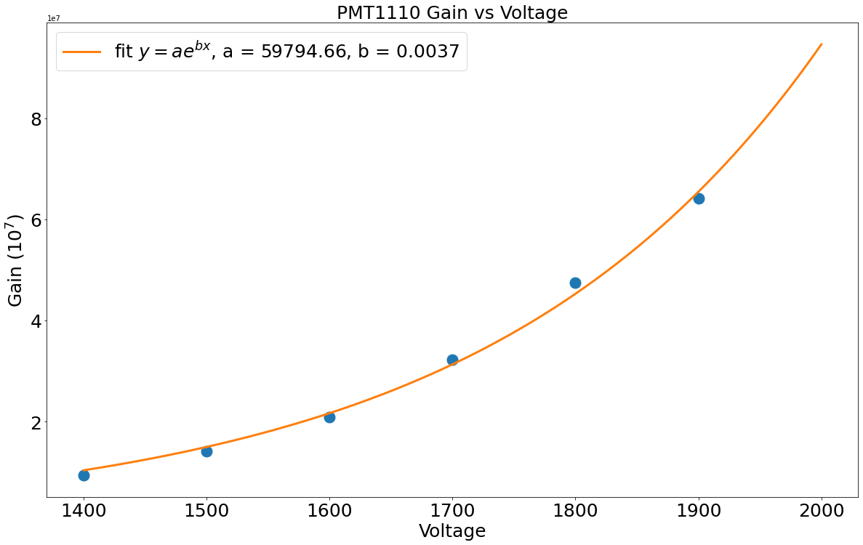
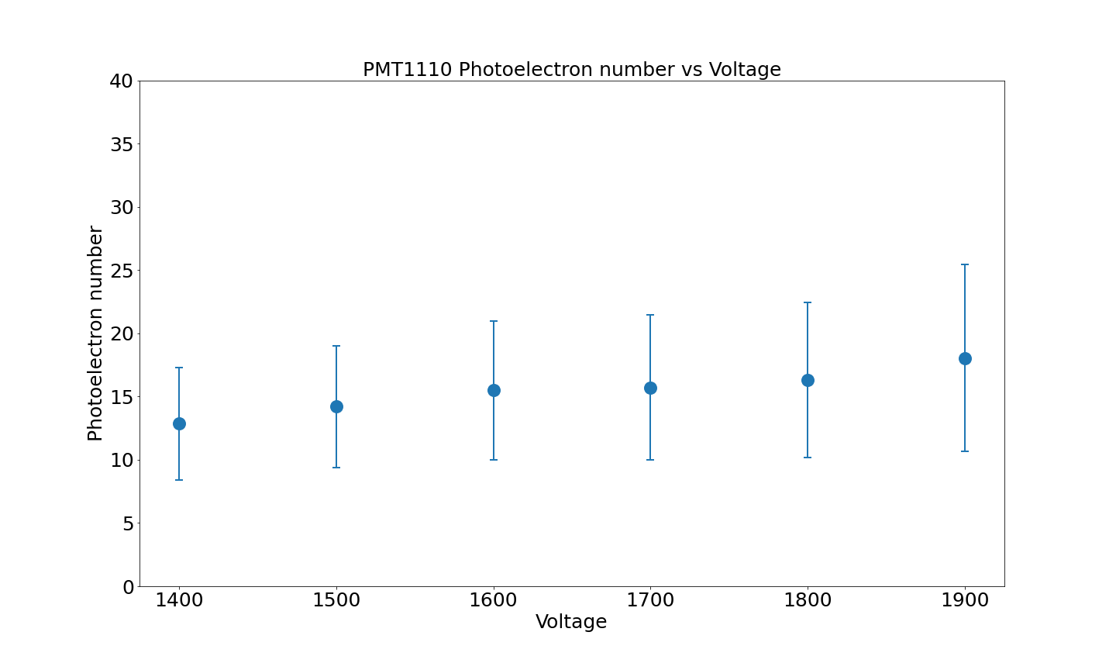
PMT1110

Slide 15
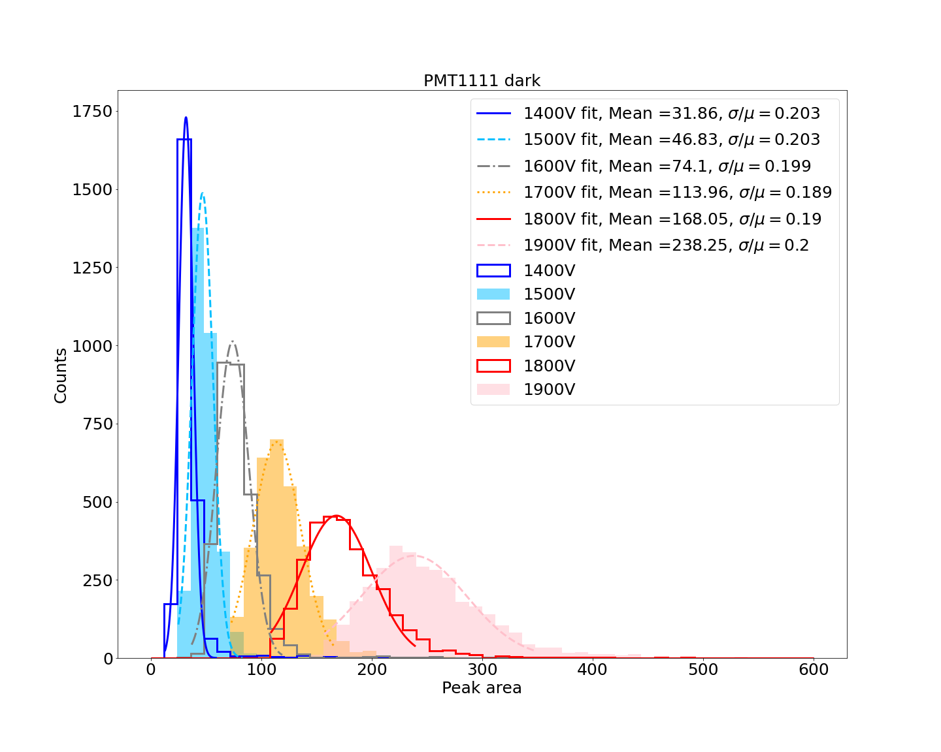
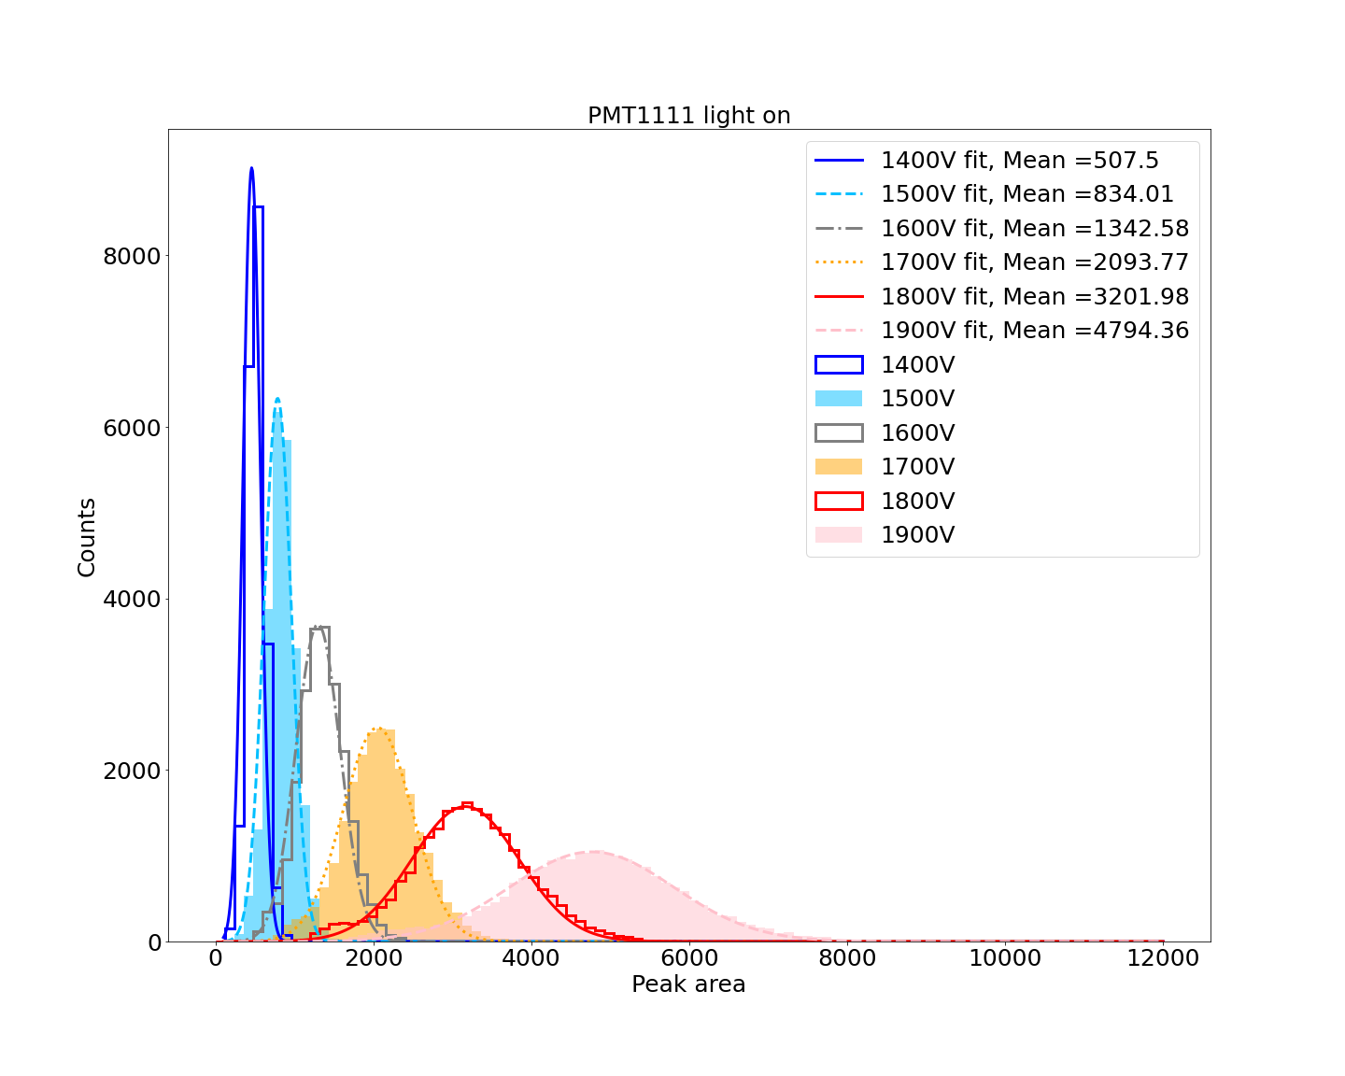
PMT1111

Slide 16
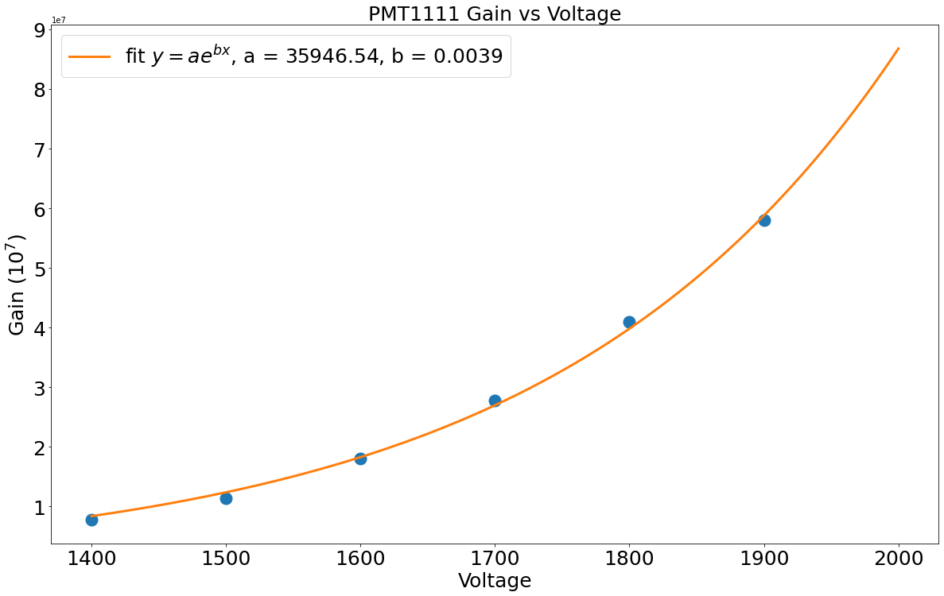
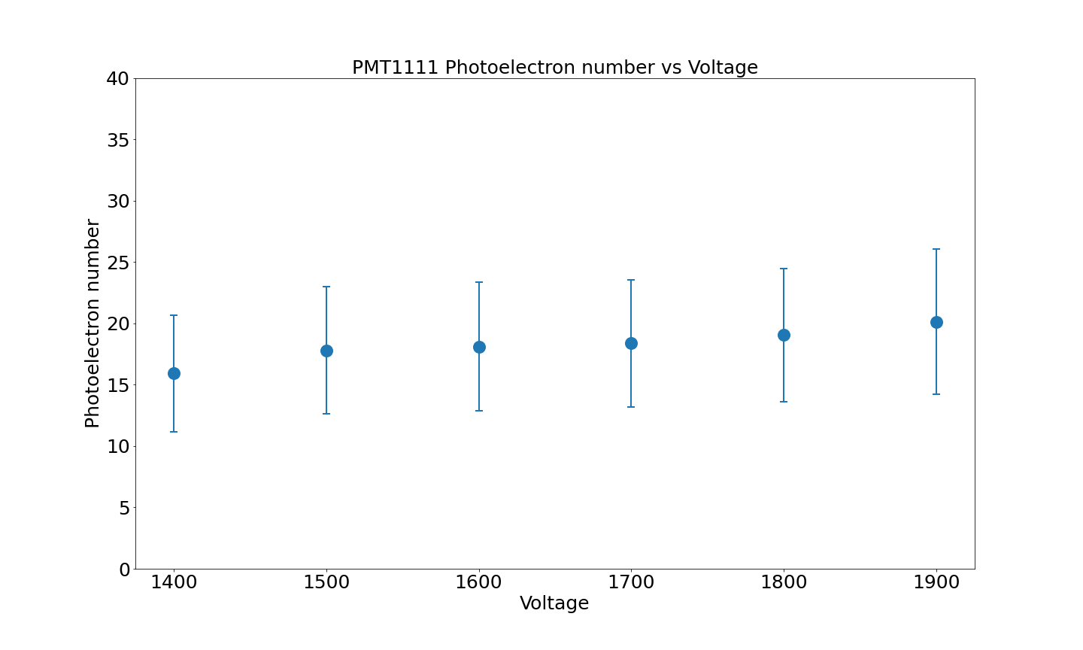
PMT1111

Slide 17
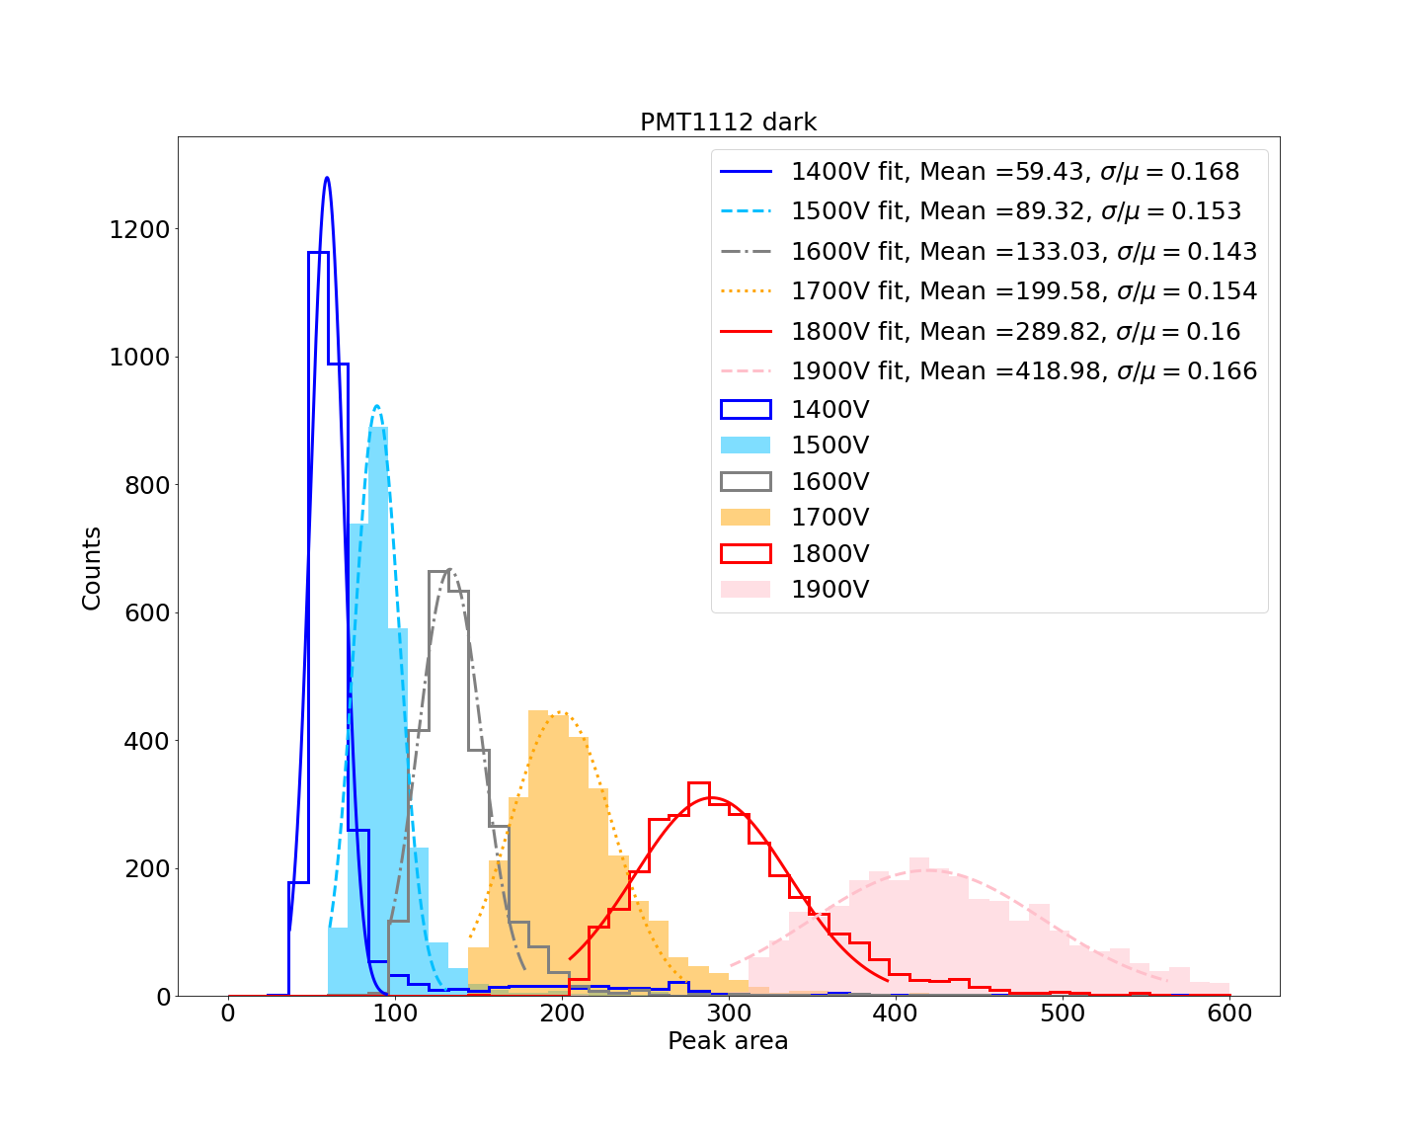
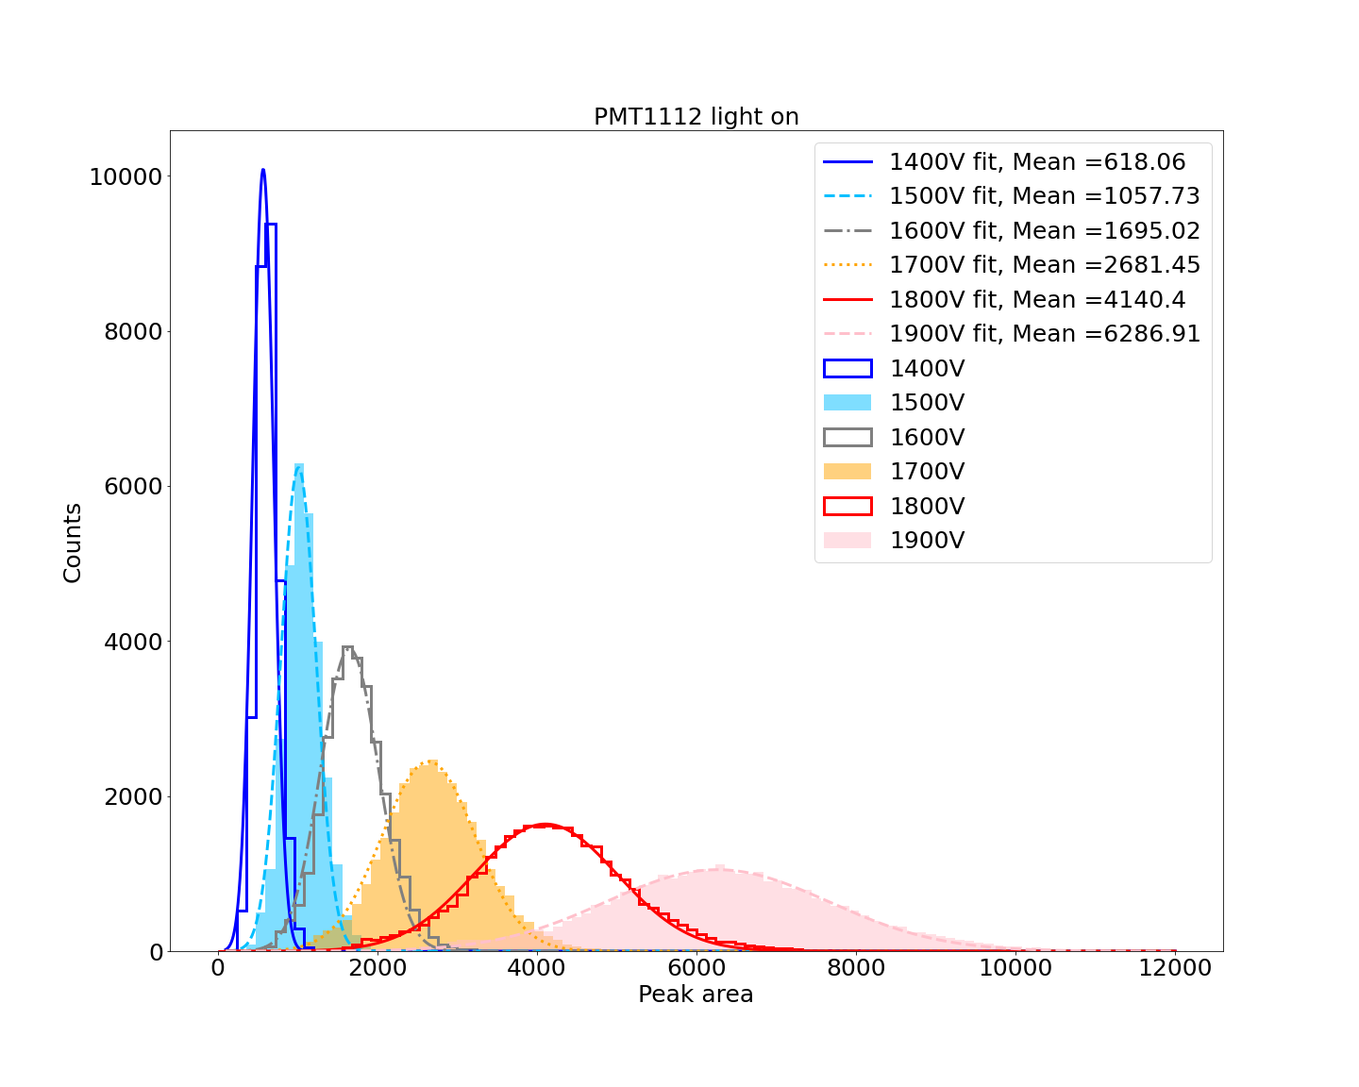
PMT1112

Slide 18
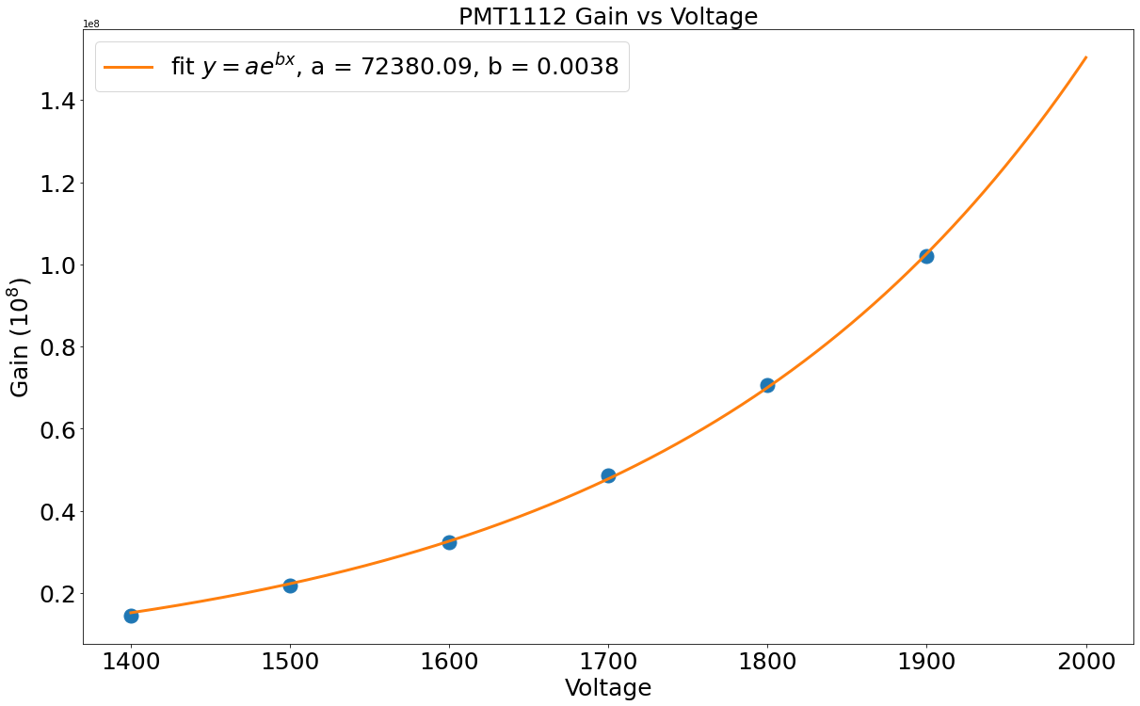
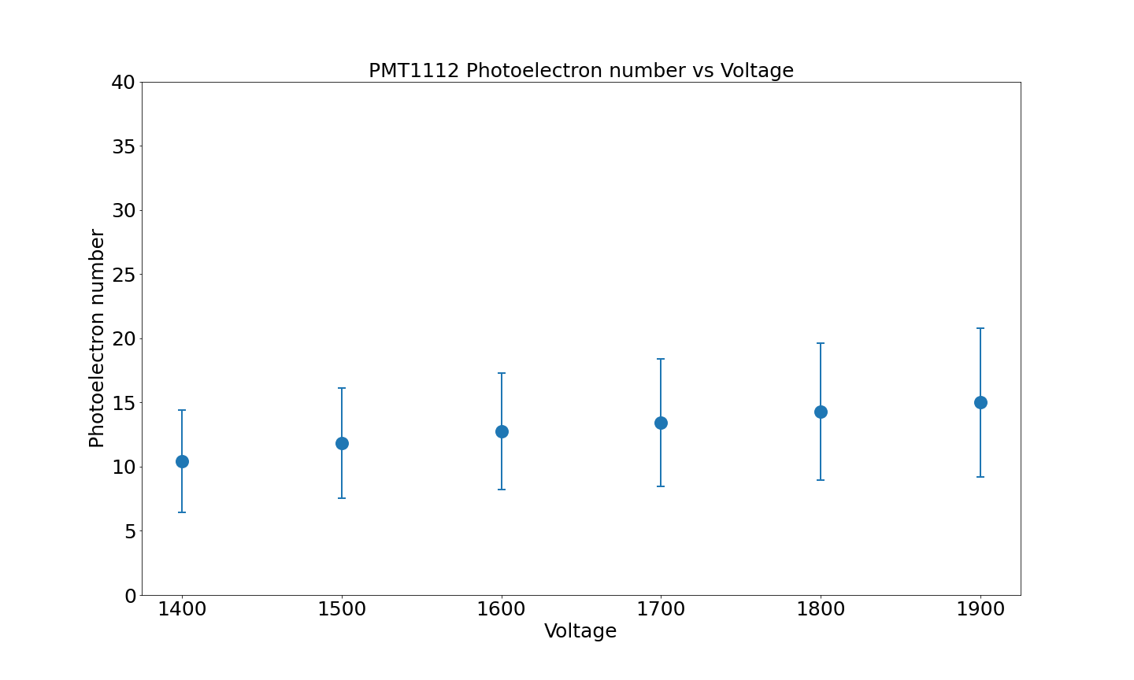
PMT1112

Slide 19
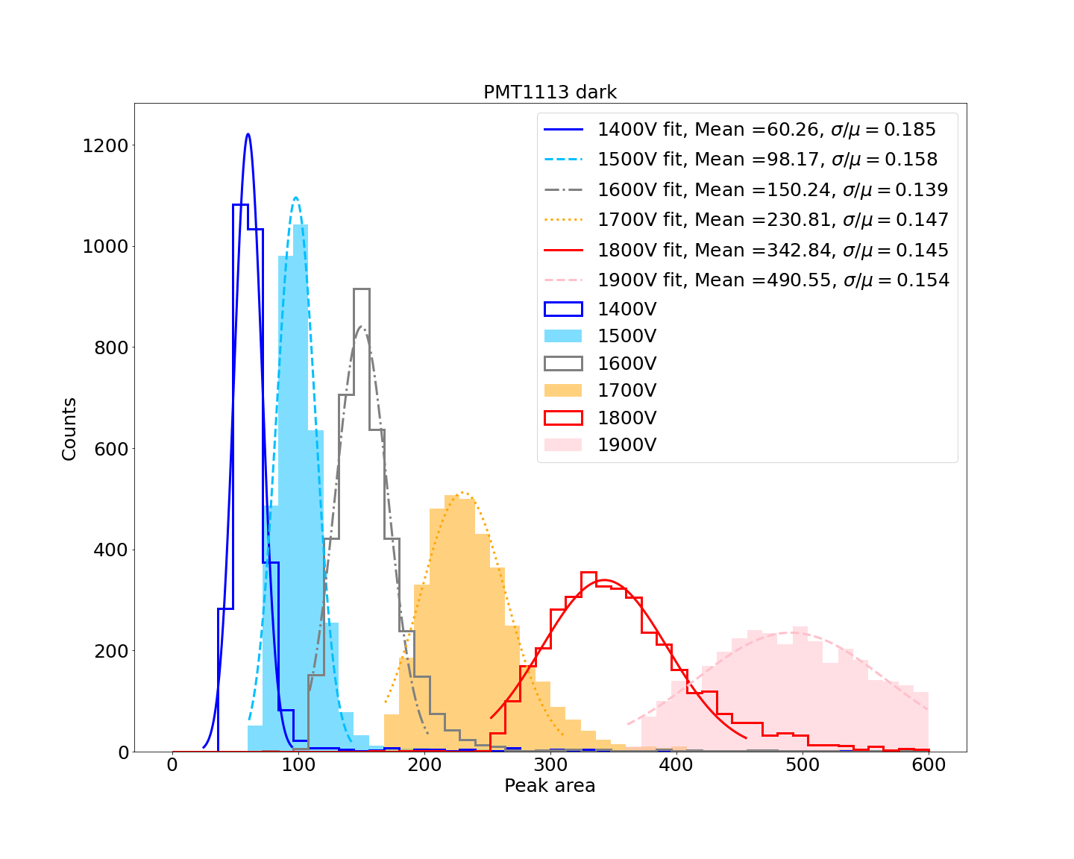
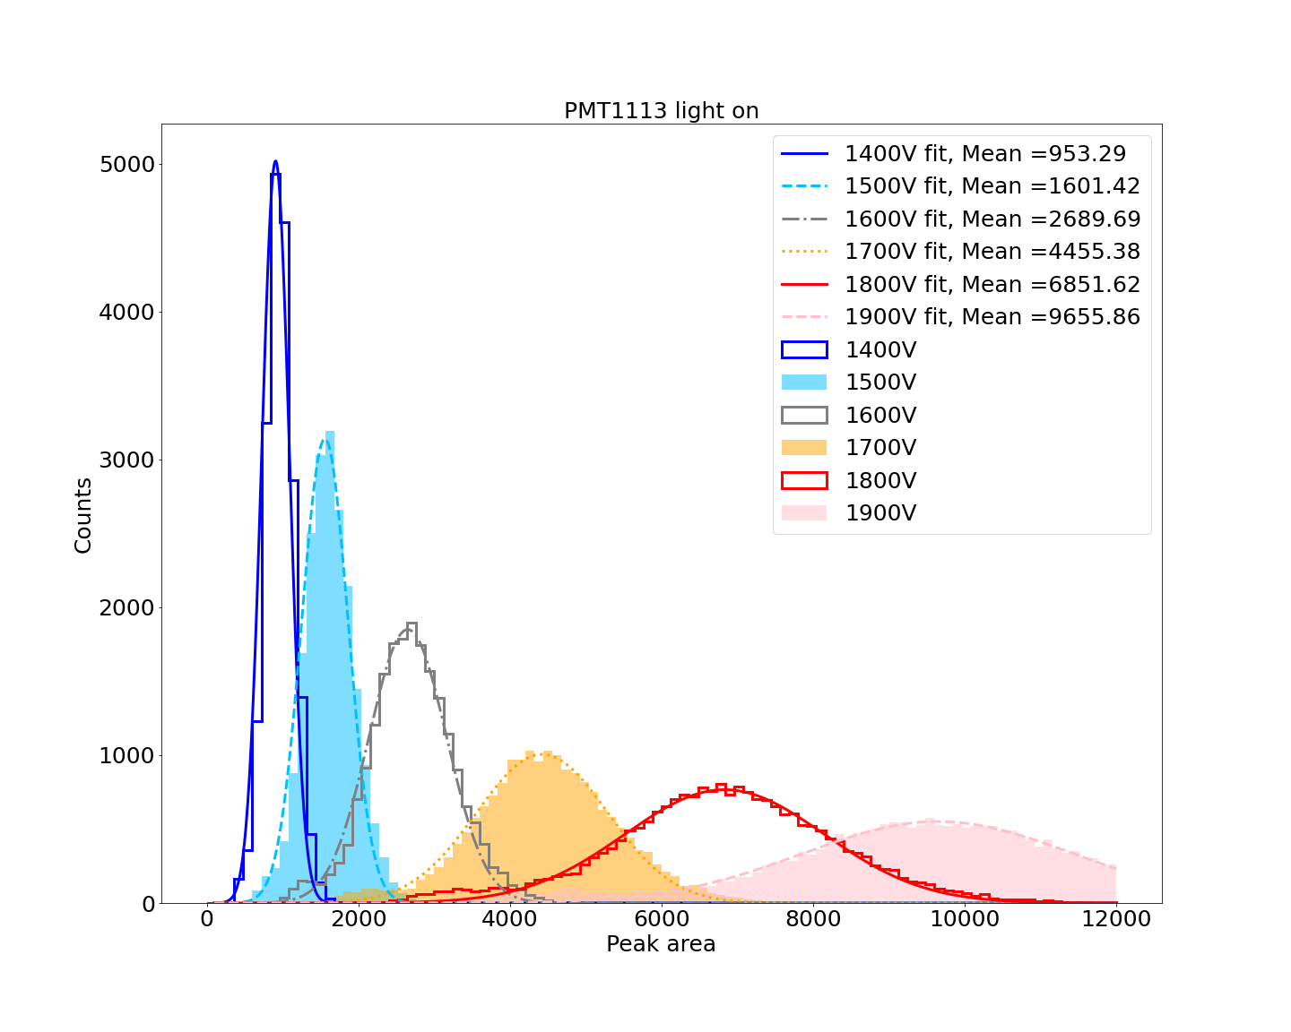
PMT1113

Slide 20
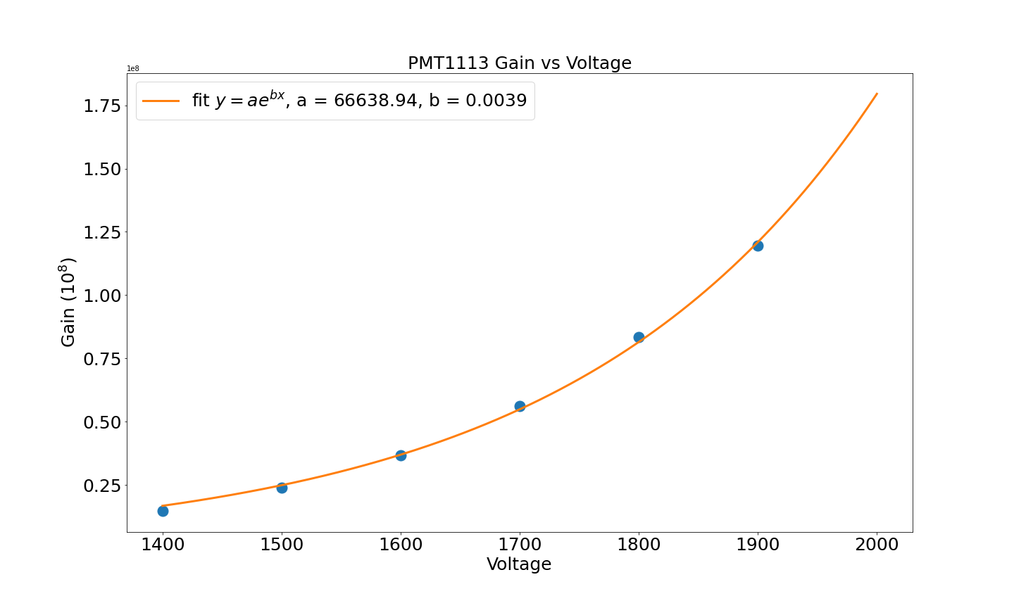
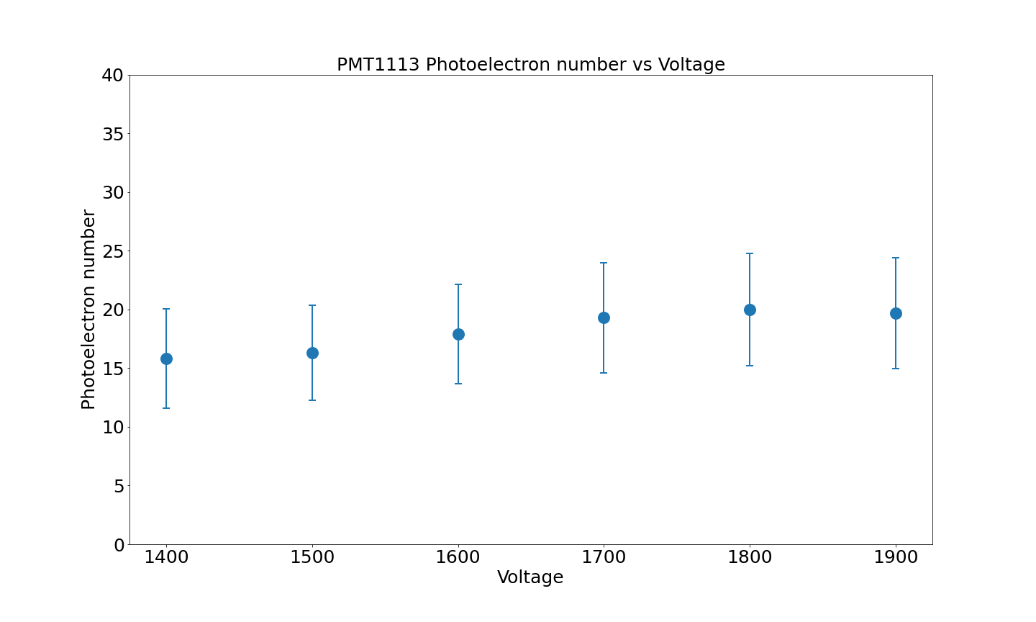
PMT1113

Slide 21
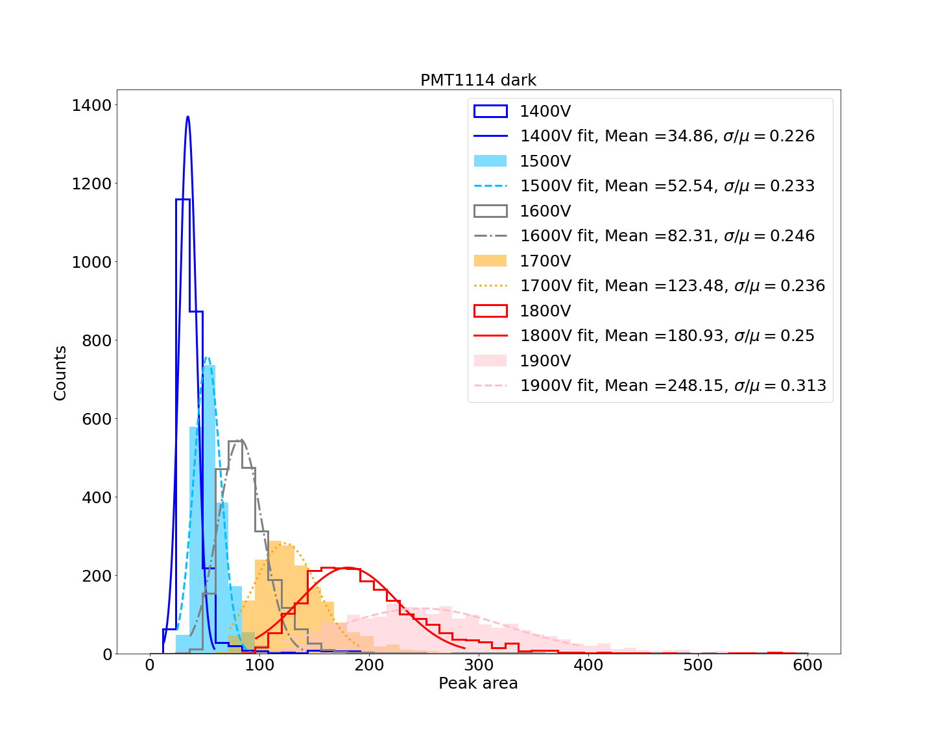
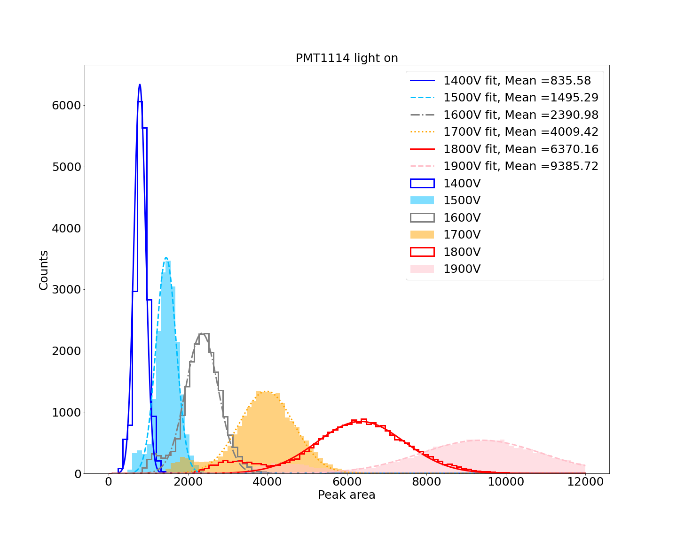
PMT1114

Slide 22
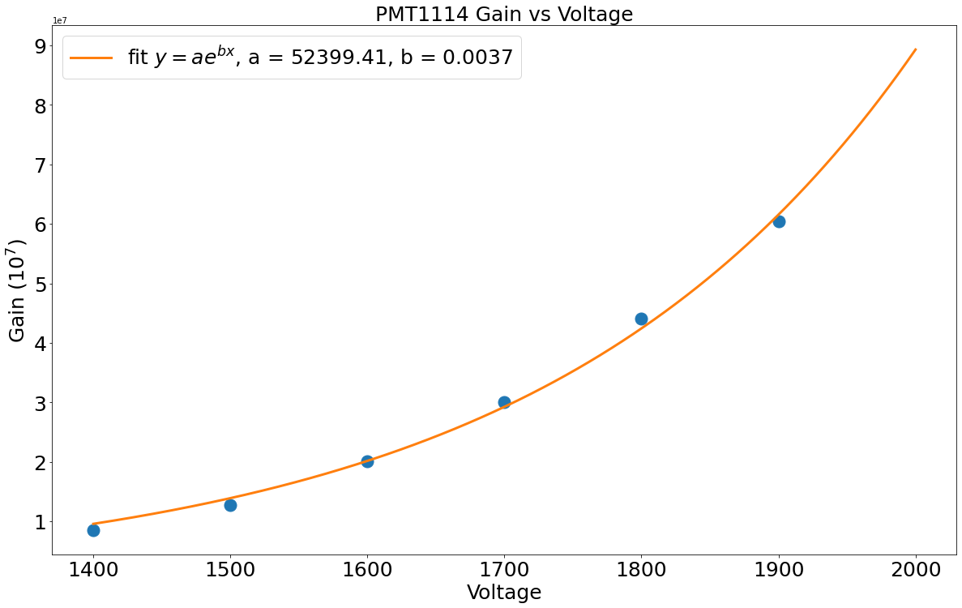
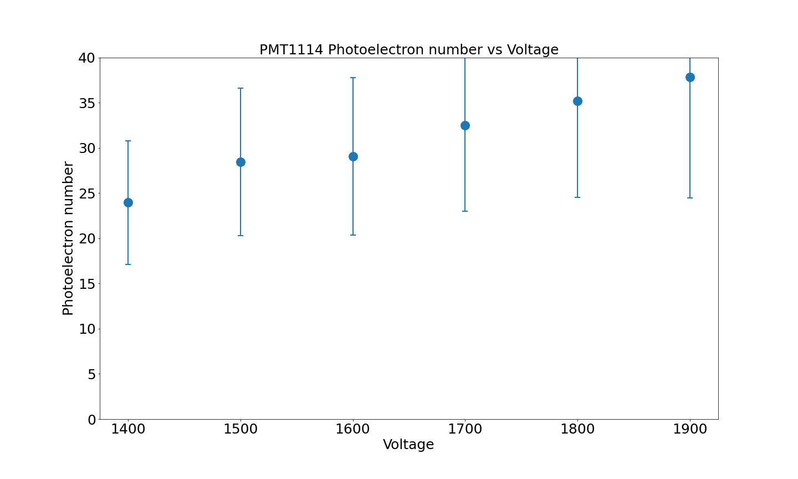
PMT1114

Slide 23
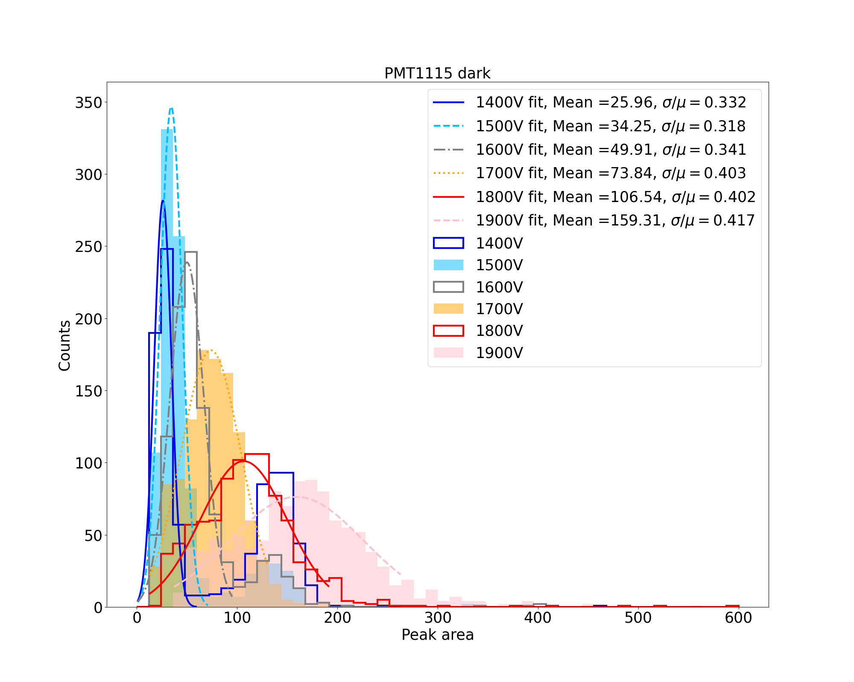
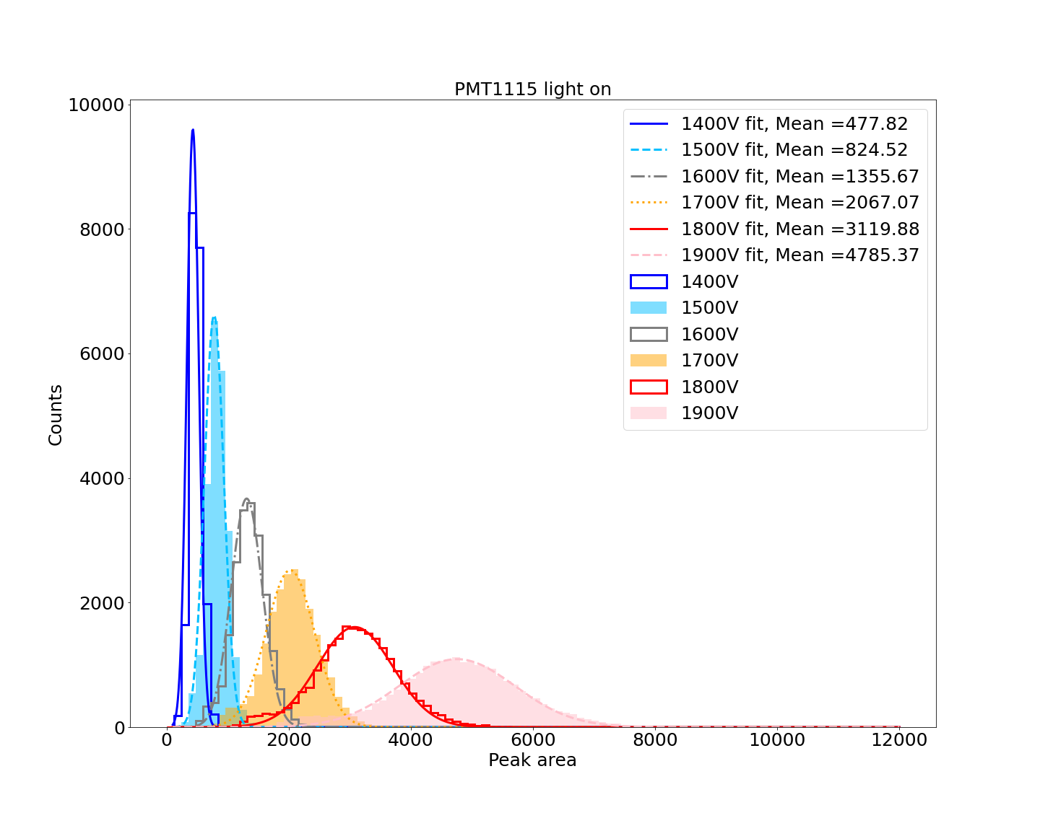
PMT1115

Slide 24
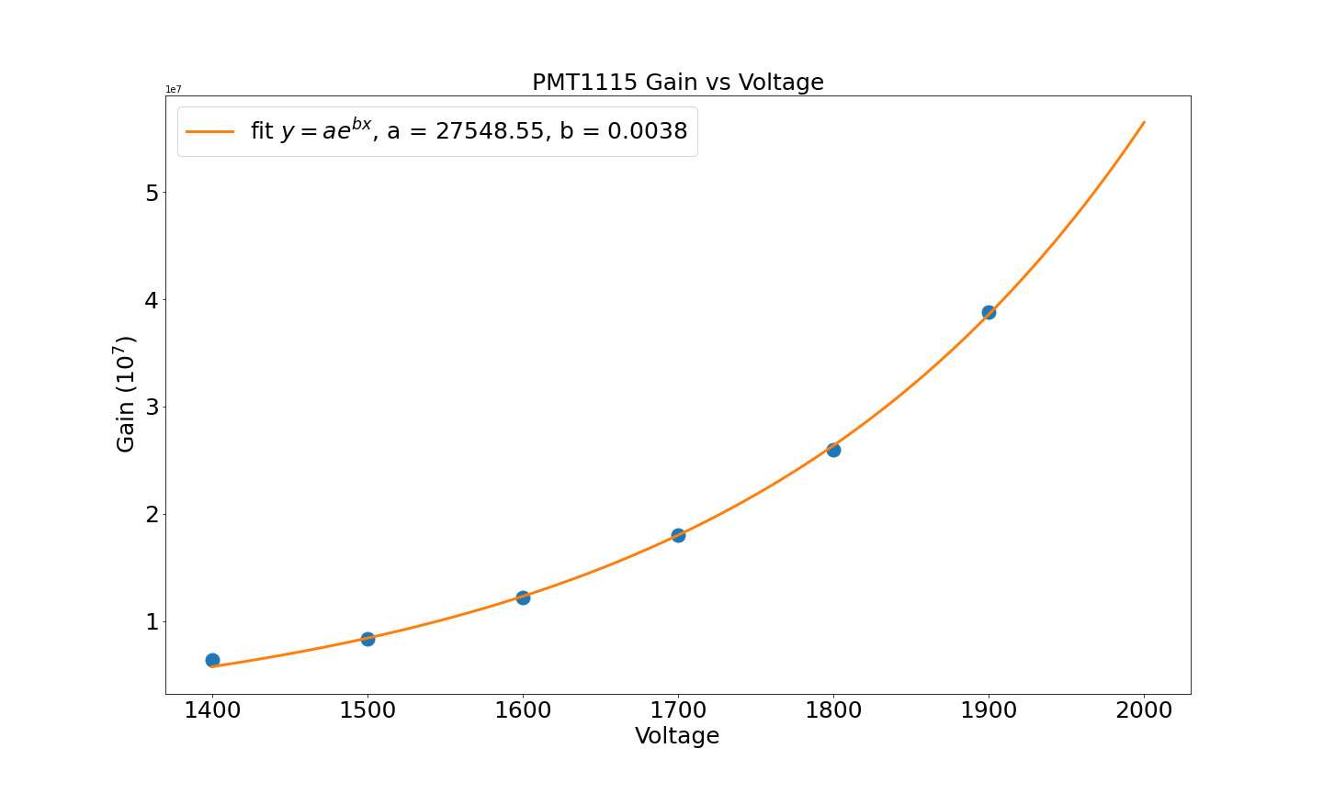
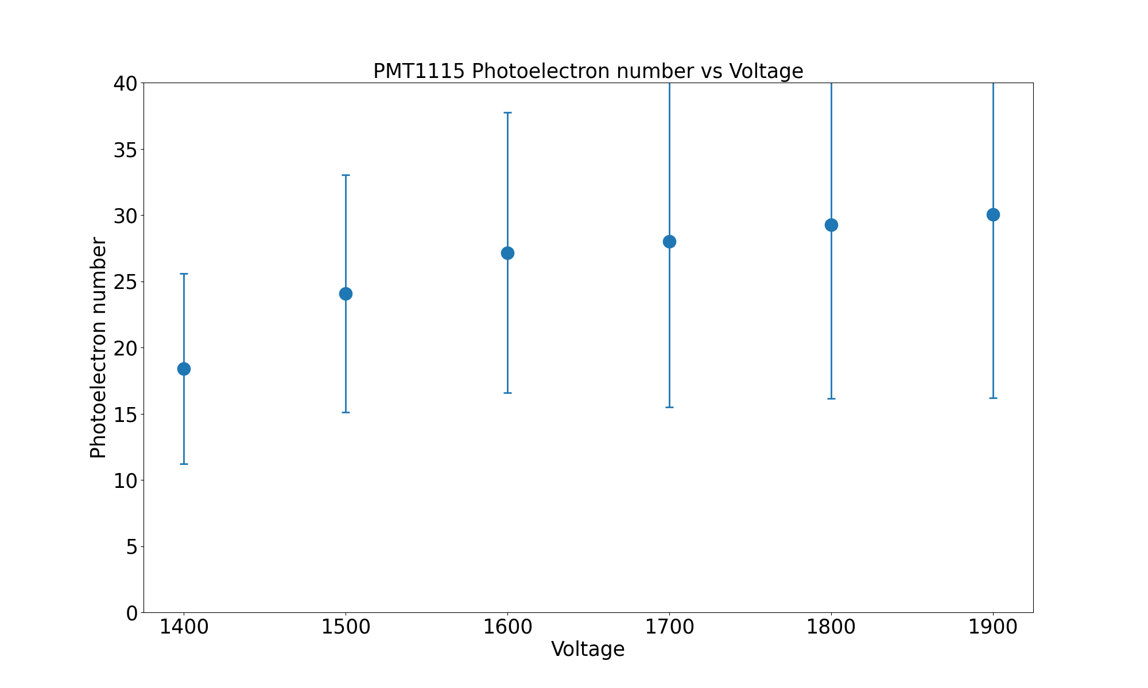
PMT1115

Slide 25
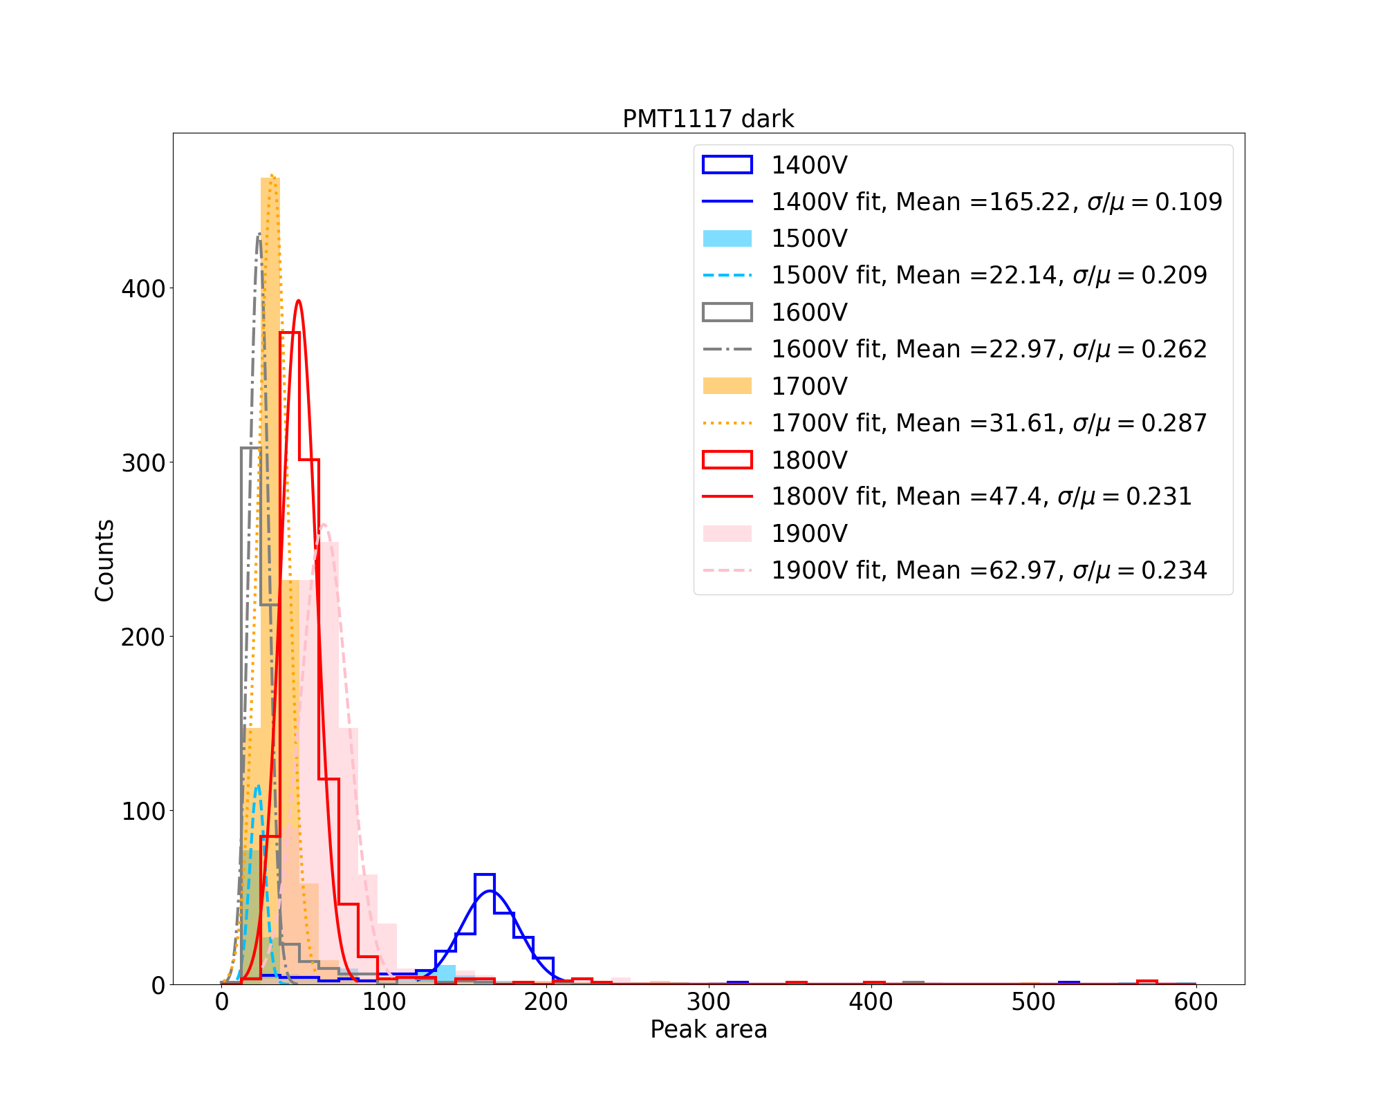
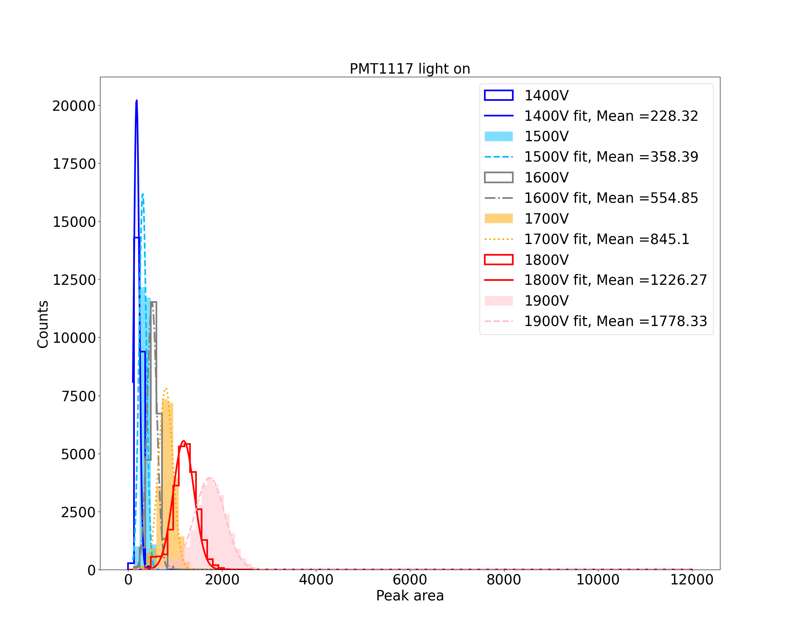
PMT1117

Slide 26
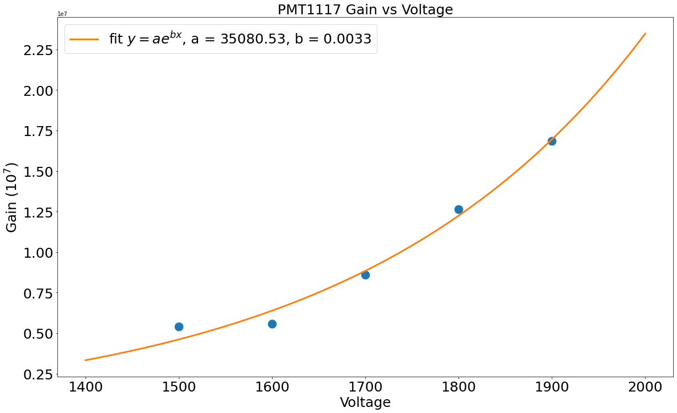
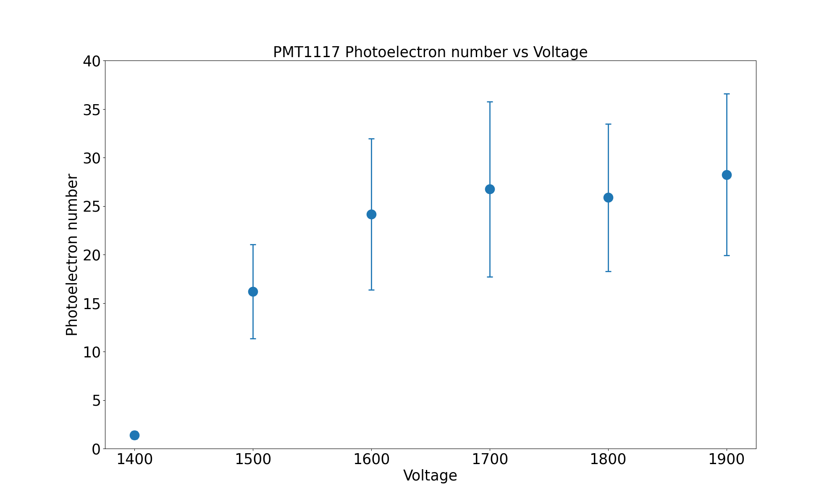
PMT1117

Slide 27
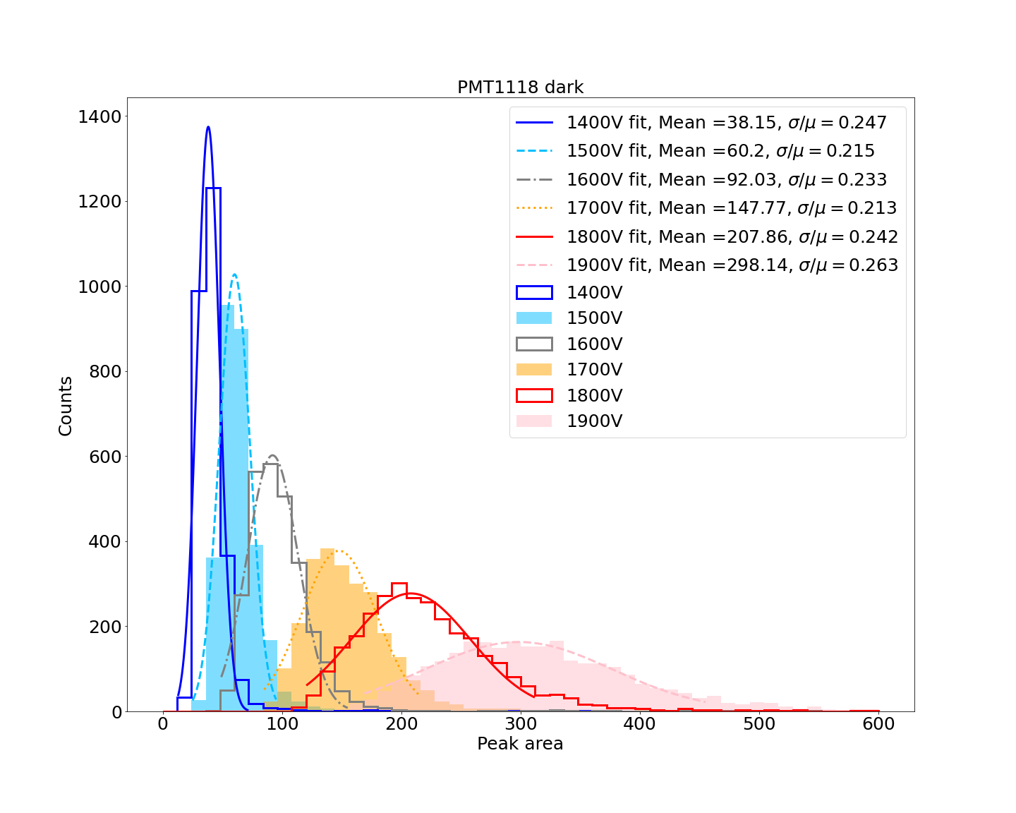
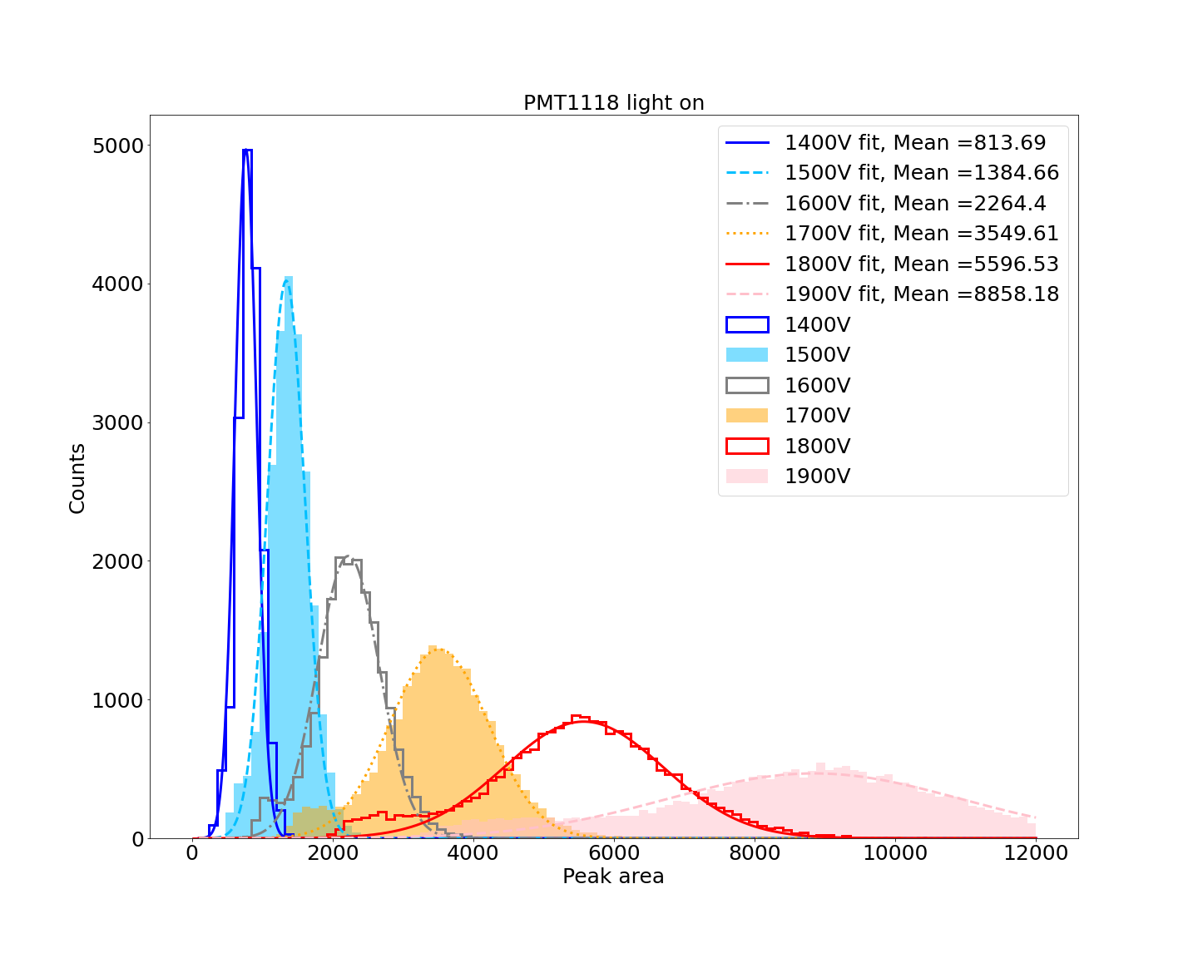
PMT1118

Slide 28
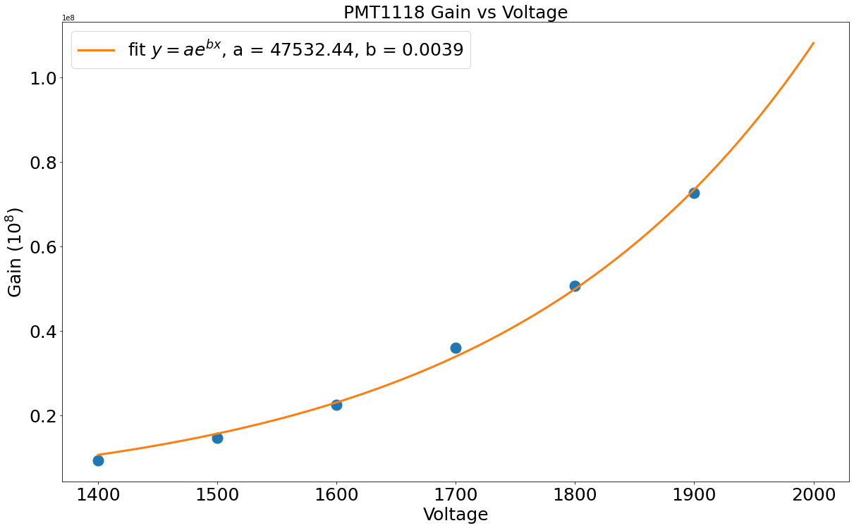
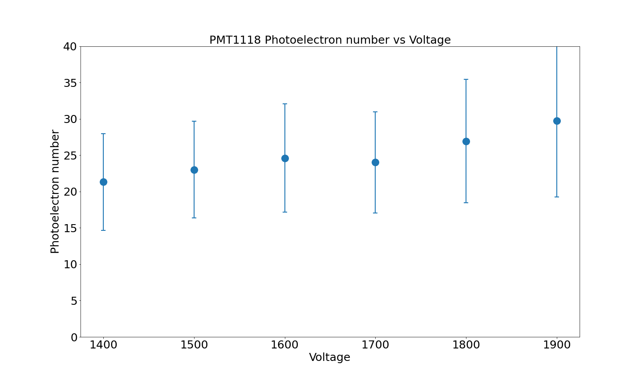
PMT1118

Slide 29
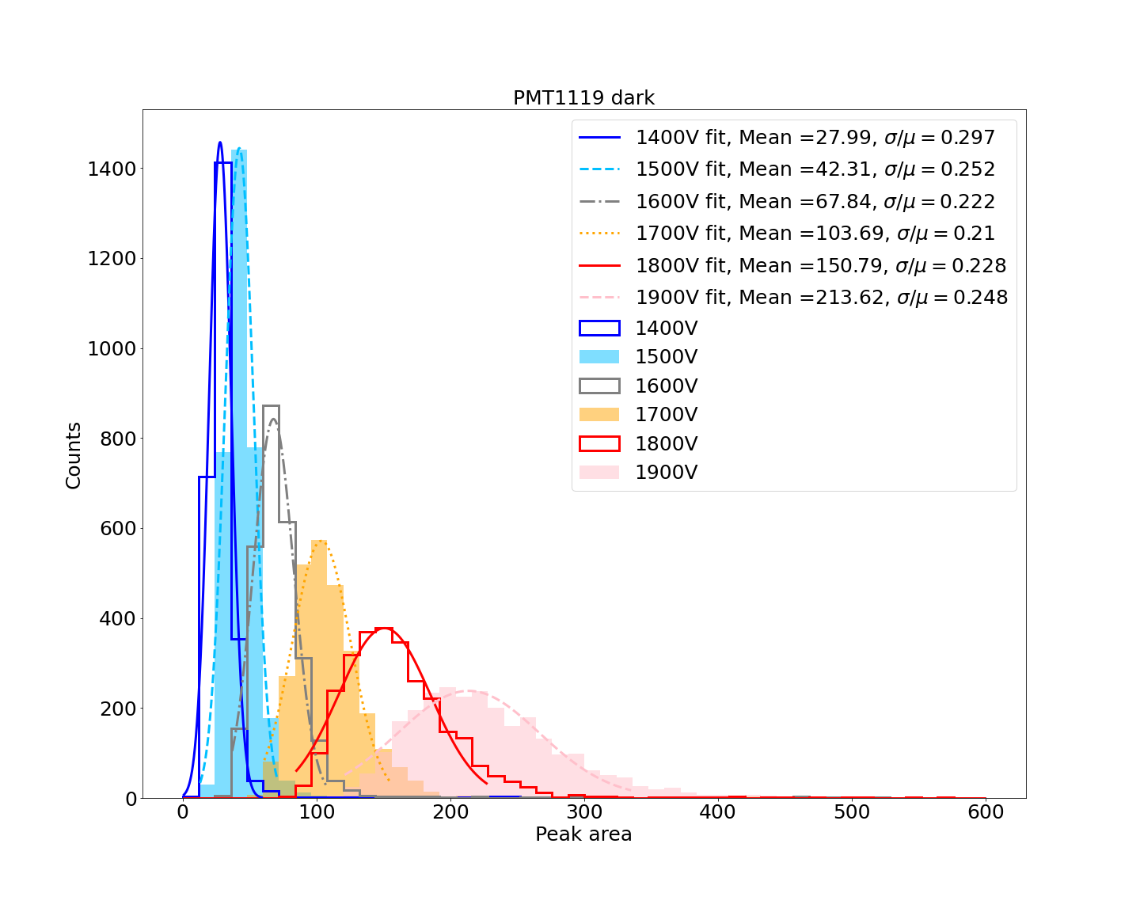
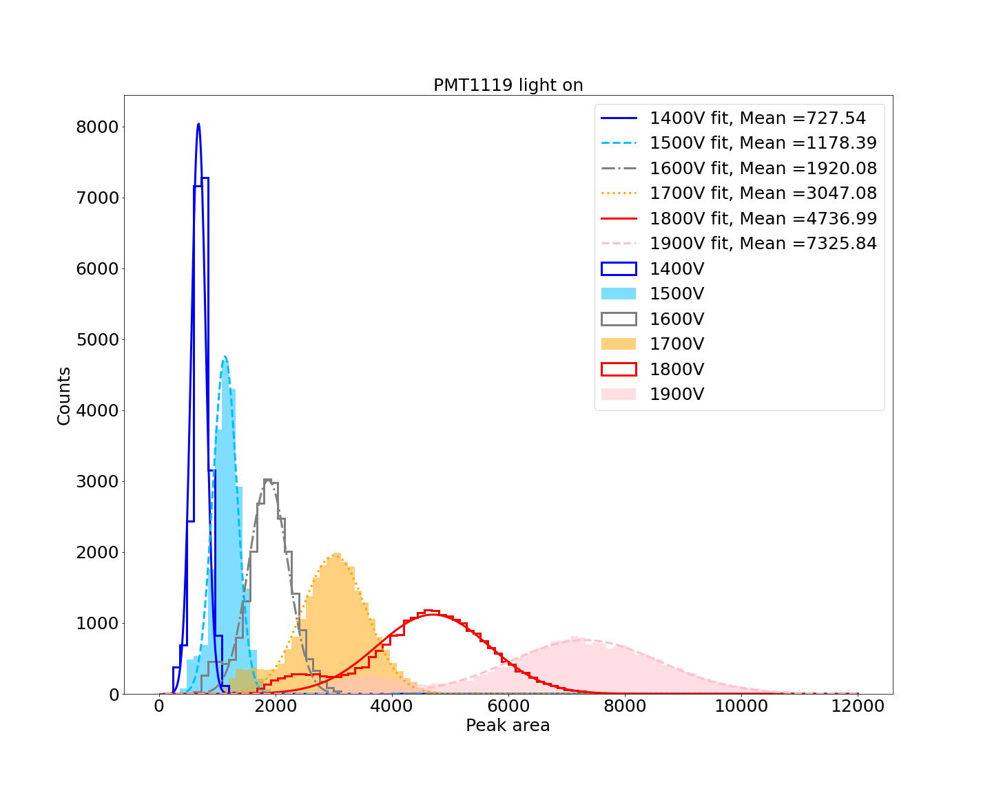
PMT1119

Slide 30


PMT1119

Slide 31


PMT1123

Slide 32


PMT1123

Slide 33


PMT1125

Slide 34


PMT1125

Slide 35

Dark Rate

Slide 36

Resolution

Slide 37

PMT1123
Test Voltage: 1900V
Dark rate on the test sheet: 1200 Hz
Mean Area in dark box test: 117

Slide 38

PMT1115
Test Voltage: 1900V
Dark rate on the test sheet: 900 Hz
Mean Area in dark box test: 159

Slide 39

PMT1107
Test Voltage: 1822V
Dark rate on the test sheet: 1200 Hz
Mean Area in dark box test: 159

Slide 40

PMT1119
Test Voltage: 1819V
Dark rate on the test sheet: 1200 Hz
Mean Area in dark box test: 159

Slide 41

PMT1111
Test Voltage: 1792V
Dark rate on the test sheet: 1000 Hz
Mean Area in dark box test: 159

Slide 42

PMT1114
Test Voltage: 1774V
Dark rate on the test sheet: 1400 Hz
Mean Area in dark box test: 159

Slide 43

PMT1110
Test Voltage: 1756V
Dark rate on the test sheet: 1100 Hz
Mean Area in dark box test: 159

Slide 44

PMT1118
Test Voltage: 1732V
Dark rate on the test sheet: 1900 Hz
Mean Area in dark box test: 159

Slide 45

PMT1125
Test Voltage: 1715V
Dark rate on the test sheet: 1500 Hz
Mean Area in dark box test: 159

Slide 46

PMT1109
Test Voltage: 1706V
Dark rate on the test sheet: 1500 Hz
Mean Area in dark box test: 159

Slide 47

PMT1108
Test Voltage: 1704V
Dark rate on the test sheet: 1800 Hz
Mean Area in dark box test: 159

Slide 48

PMT1112
Test Voltage: 1643V
Dark rate on the test sheet: 1300 Hz
Mean Area in dark box test: 159

Slide 49

PMT1113
Test Voltage: 1608V
Dark rate on the test sheet: 898 Hz
Mean Area in dark box test: 159

Slide 50

PMT1117
Test Voltage: 1900V
Dark rate on the test sheet: 855 Hz
Mean Area in dark box test: 63

Slide 51
Thank you for listening!

